Slide 1
LIFE RIPARIAS early alert tool
alert.riparias.be

Slide 2
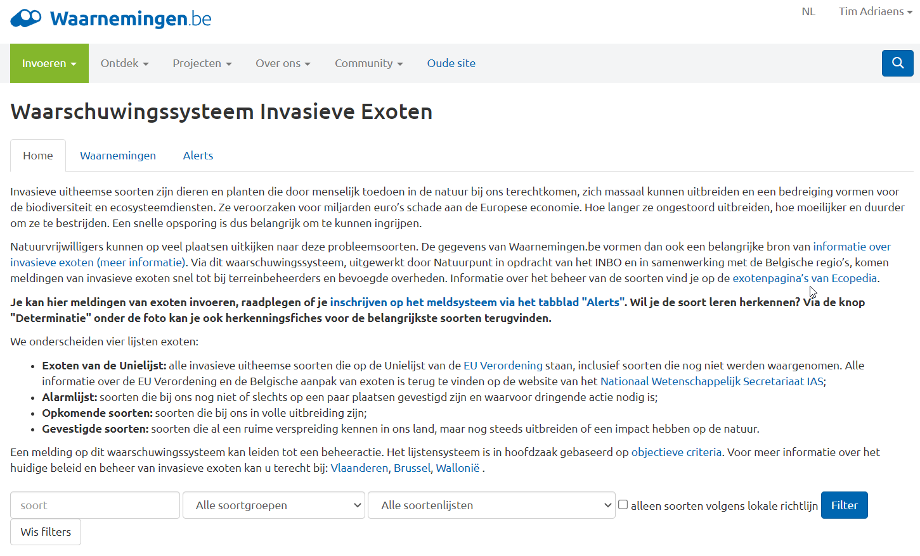
The current early warning system
Notes:
What is the LIFE RIPARIAS early alert? It’s a WEB APPLICATION.That means it is a software that has a website as “end product” (front-end in the computer science jargon) the user interacts with.

Slide 3
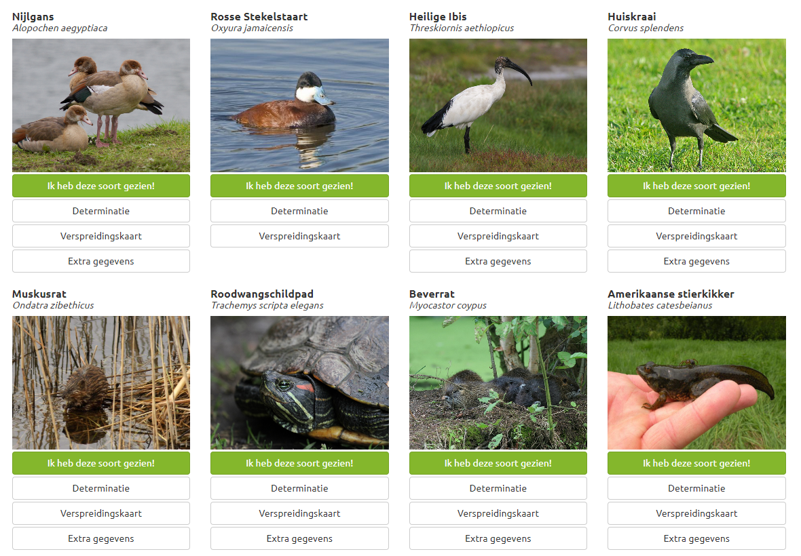
The current early warning system
Single-datasource: waarnemingen.be (citizen science)
Individual species alerts
Batch species alerts:
Union List species
(3rd update)
Emerging aliens (ISEIA)
Established aliens (ISEIA)
Alert list aliens
ISEIA
DUNIAS alert list
Notes:
What is the LIFE RIPARIAS early alert? It’s a WEB APPLICATION.That means it is a software that has a website as “end product” (front-end in the computer science jargon) the user interacts with.

Slide 4
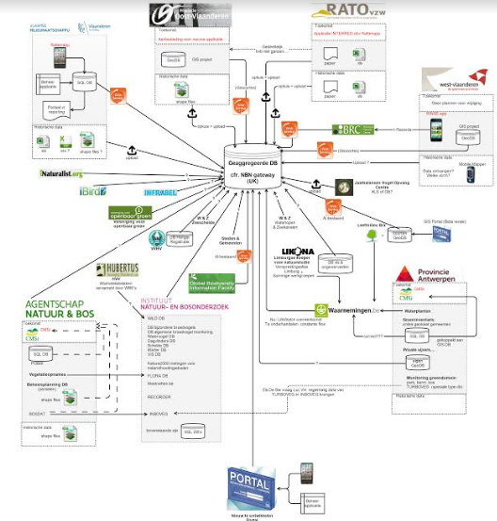
What about the other data sources

Slide 5
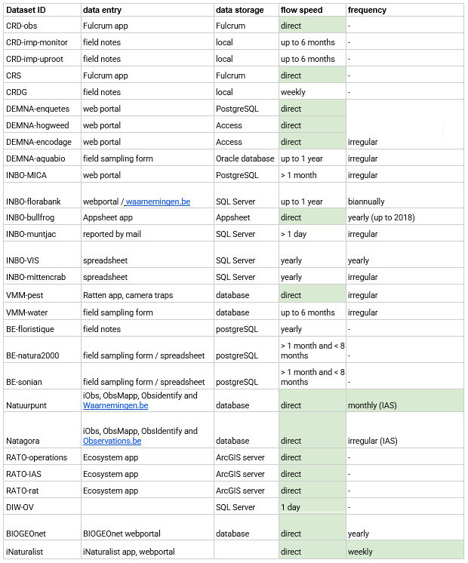
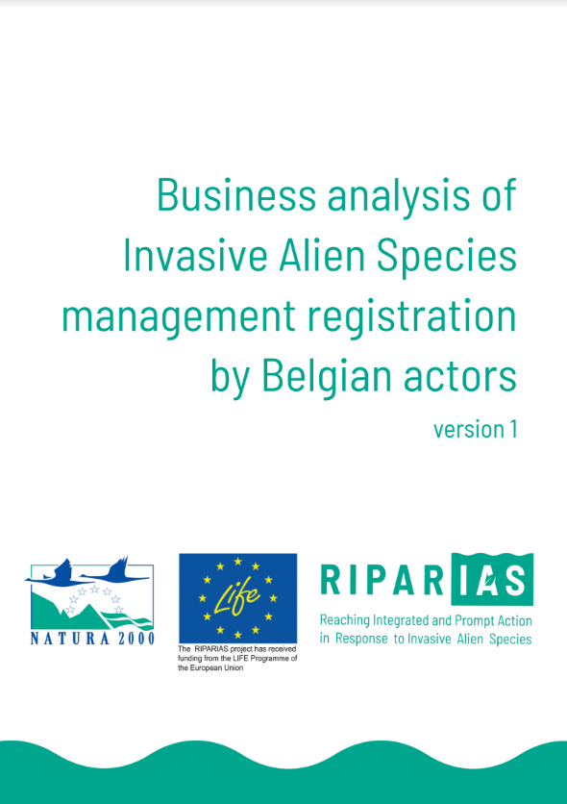
Other data sources
Notes:
What is the LIFE RIPARIAS early alert? It’s a WEB APPLICATION.That means it is a software that has a website as “end product” (front-end in the computer science jargon) the user interacts with.

Slide 6
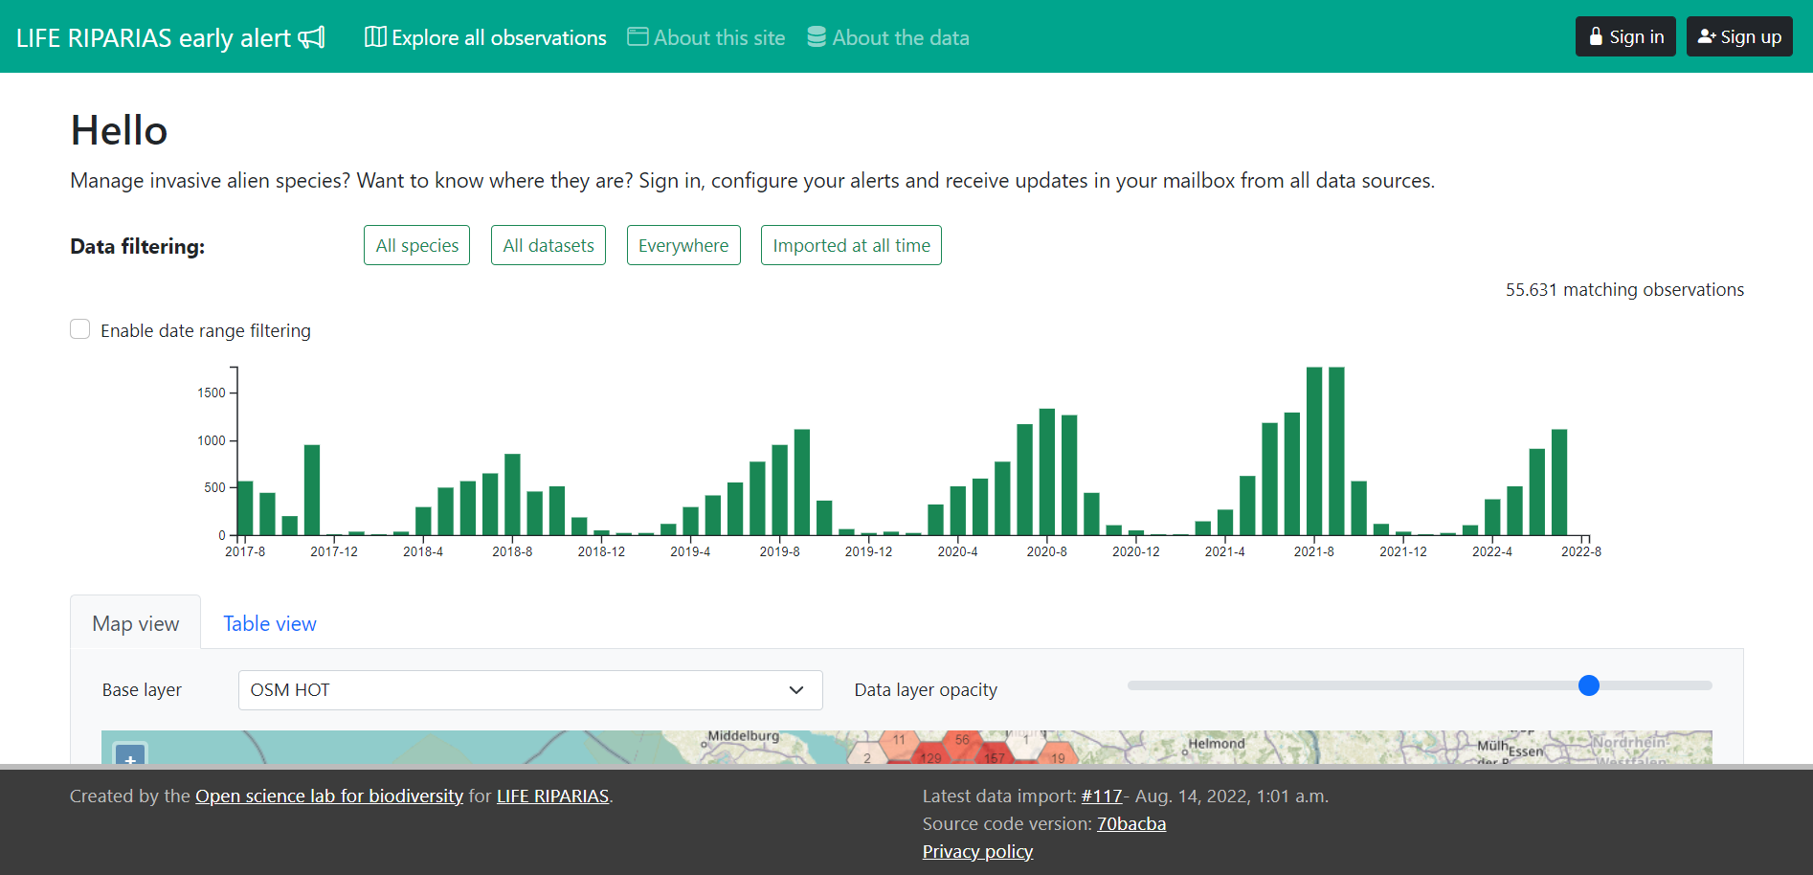
LIFE RIPARIAS early alert: web application
Notes:
What is the LIFE RIPARIAS early alert? It’s a WEB APPLICATION.That means it is a software that has a website as “end product” (front-end in the computer science jargon) the user interacts with.

Slide 7
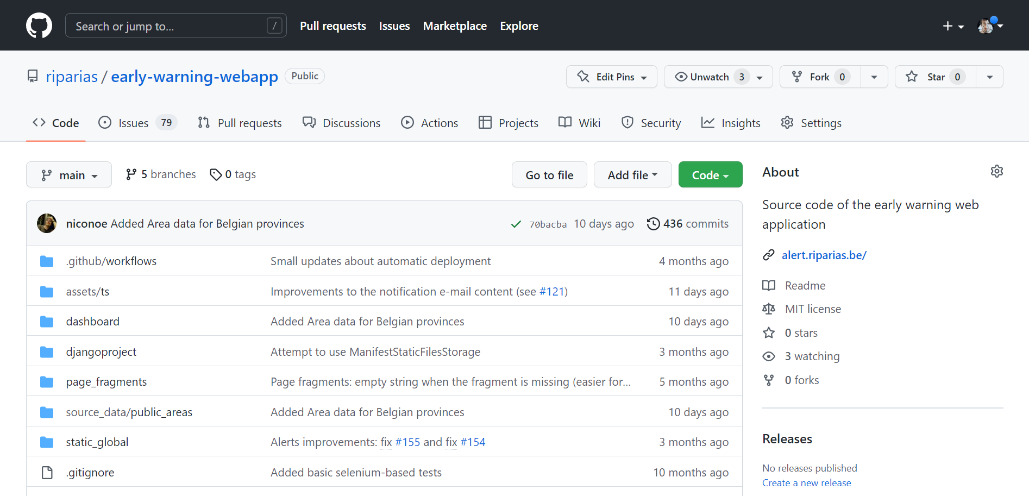
LIFE RIPARIAS early alert: web application
Open software: developed by Open science lab for biodiversity (INBO)

Slide 8
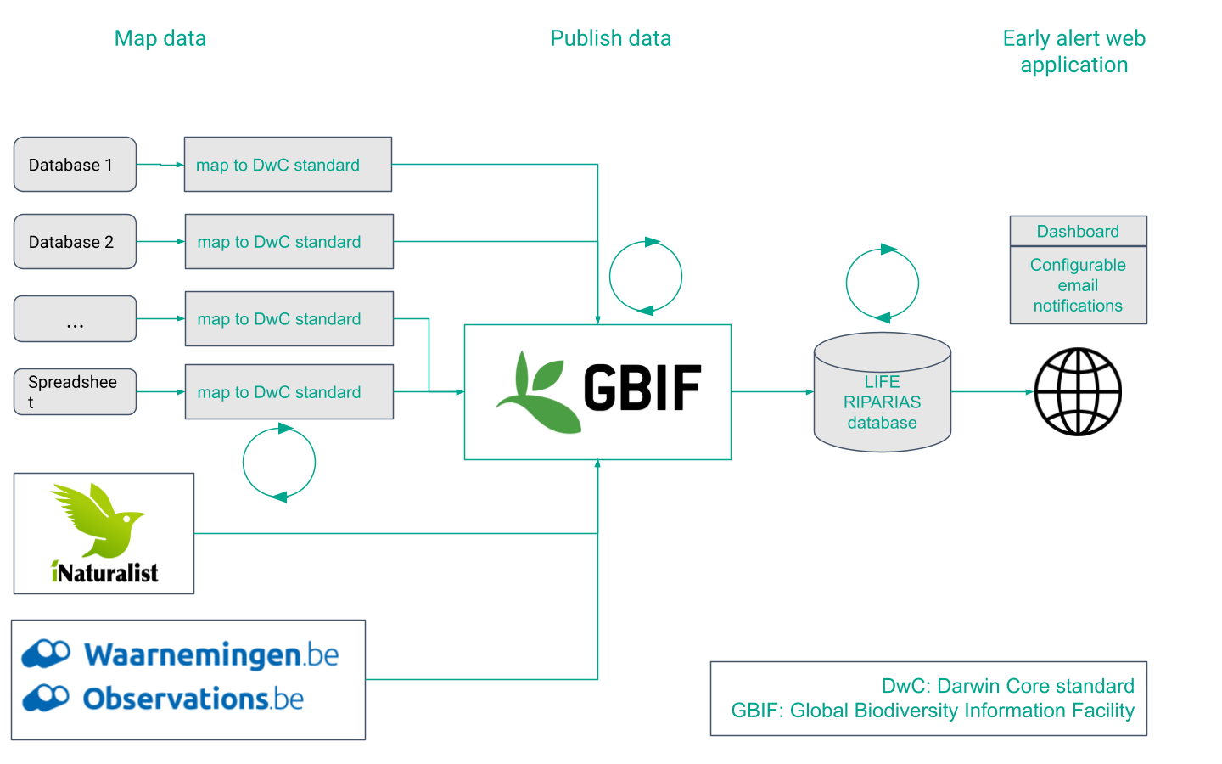
LIFE RIPARIAS early alert: the data workflow
Notes:
So, it’s very important that as many observations as possible are published on GBIF. Otherwise the early alert will be a nice tool but not really interesting for a field manager.

Slide 9
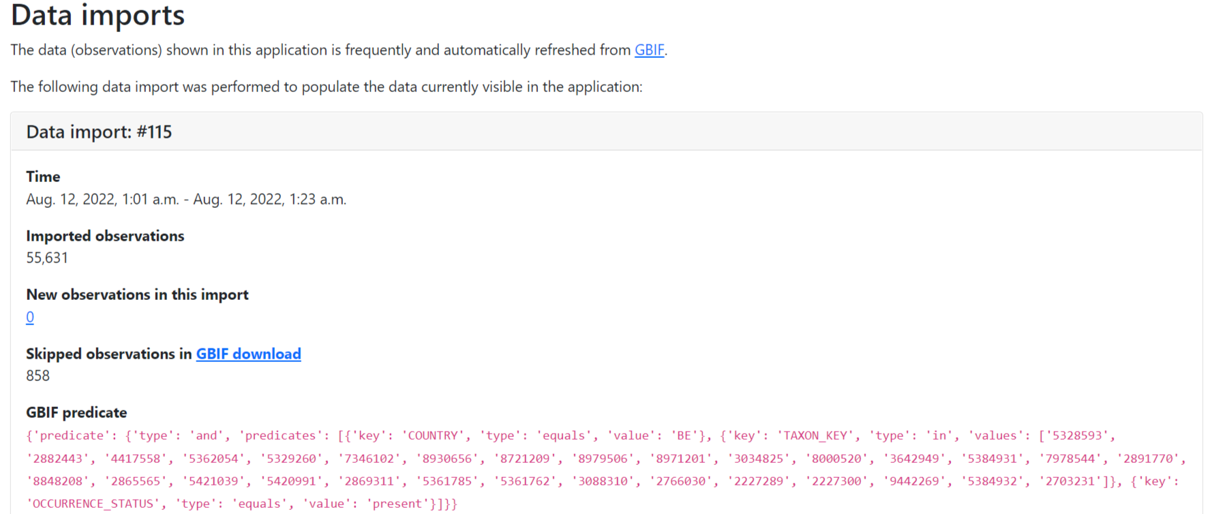
LIFE RIPARIAS early alert: about the data
GBIF-based: ALL data shown are imported daily from the Global Biodiversity Information Facility (GBIF)
Notes:
Import of data from GBIF is done every night

Slide 10
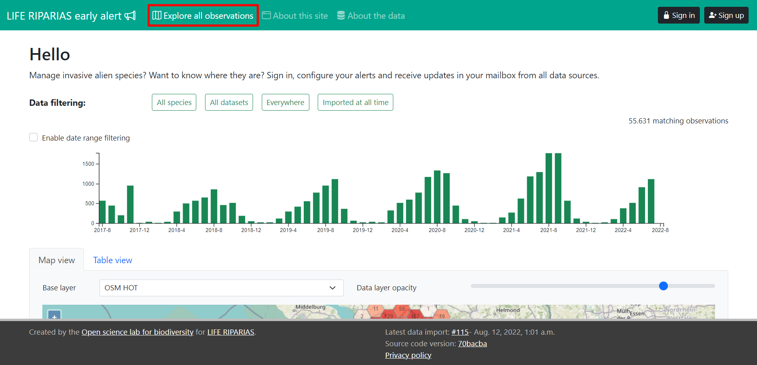
Homepage: explore observations
Notes:
No need to sign in.

Slide 11
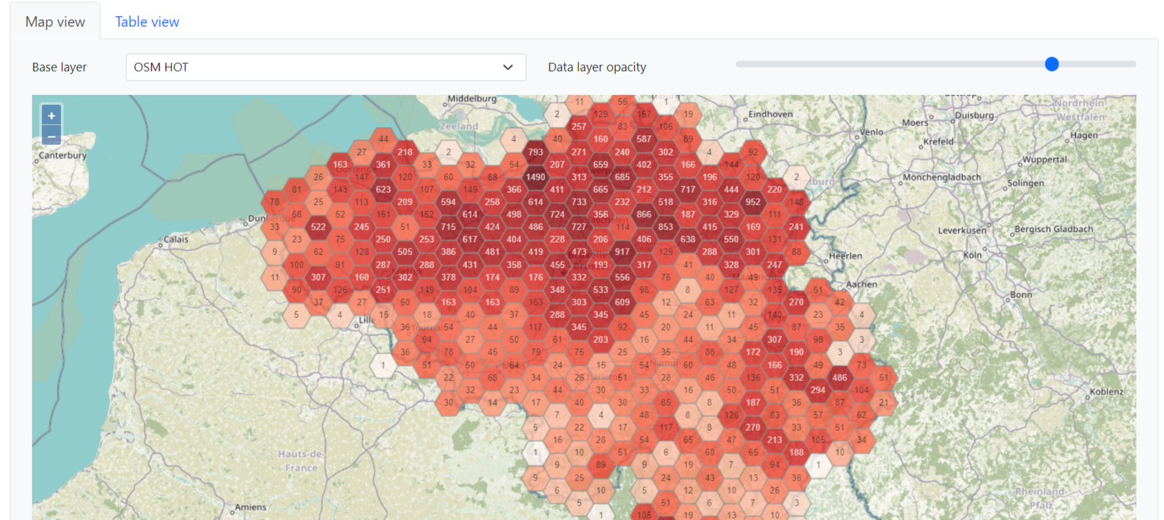
Homepage: Map view (default)
Notes:
You can:
switch among three different background maps
change the data layer opacity
Zoom in up to the level of single observations

Slide 12
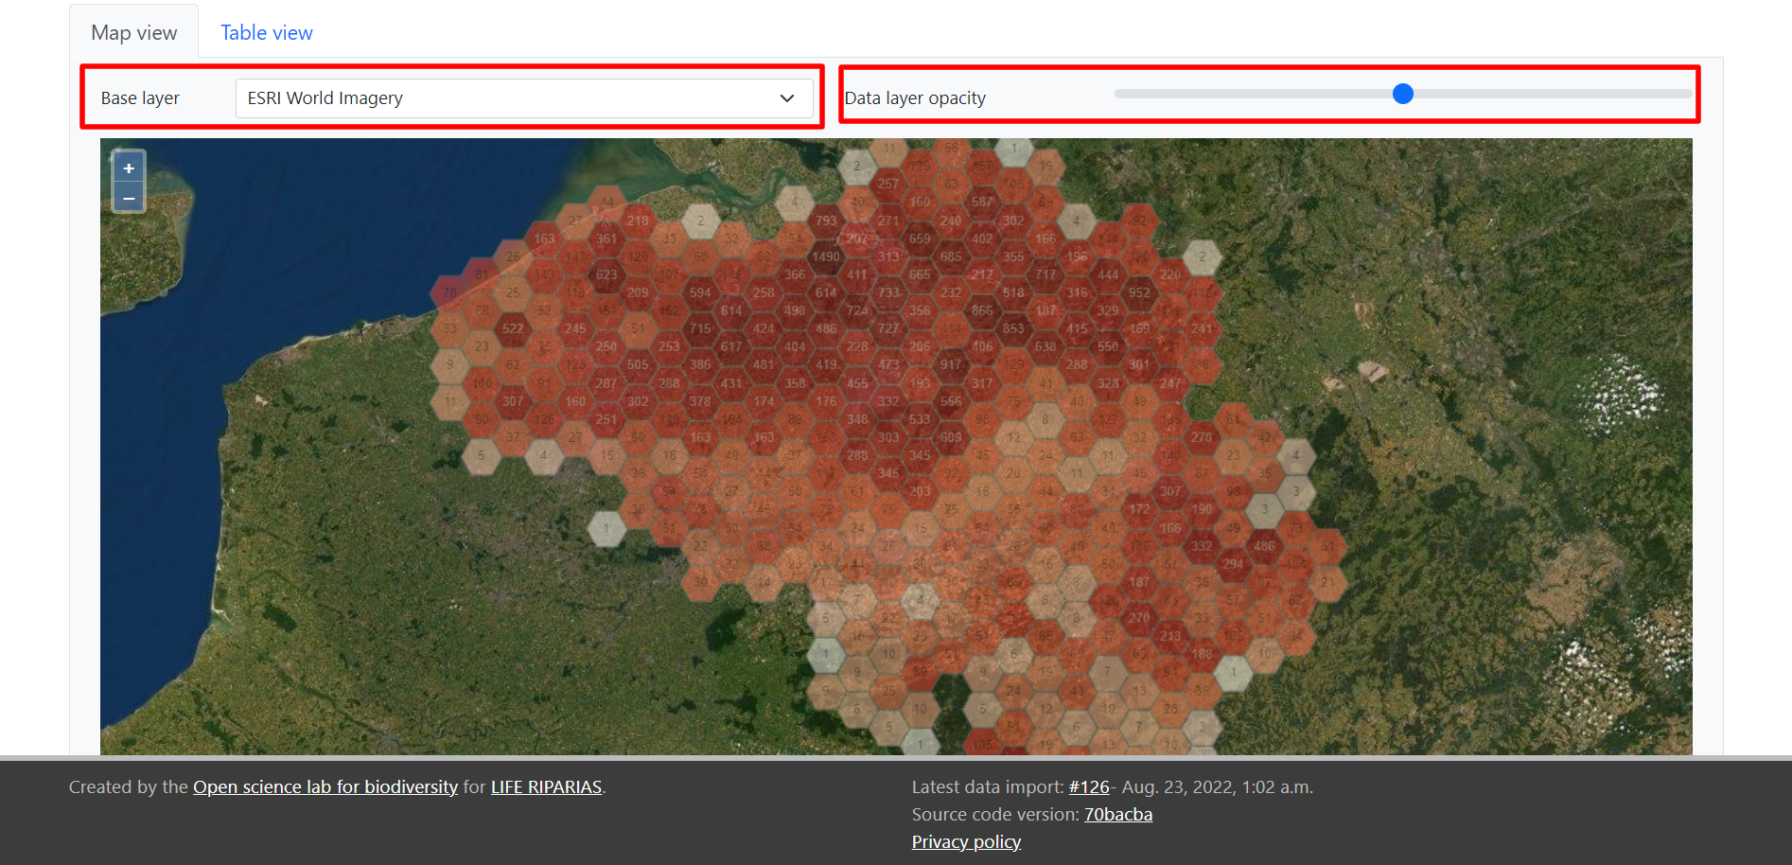
Homepage: Map view (default)
Notes:
You can:
switch among three different background maps
change the data layer opacity
Zoom in up to the level of single observations

Slide 13
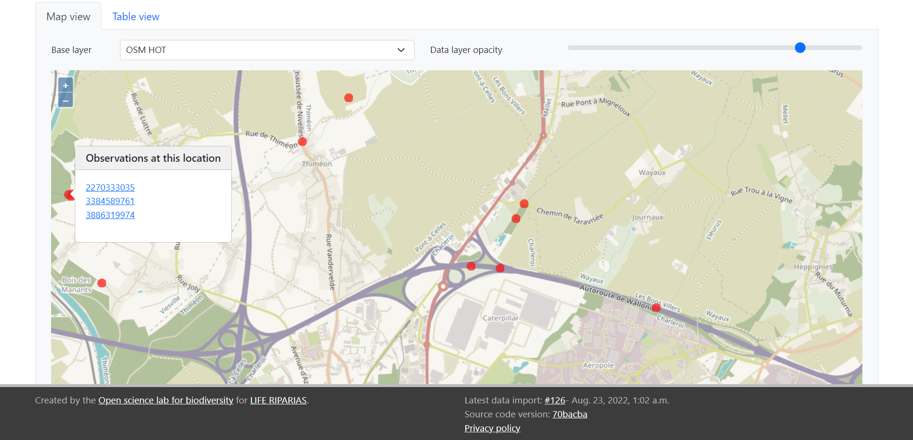
Homepage: Map view (default)
Notes:
You can:
switch among three different background maps
change the data layer opacity
Zoom in up to the level of single observations

Slide 14
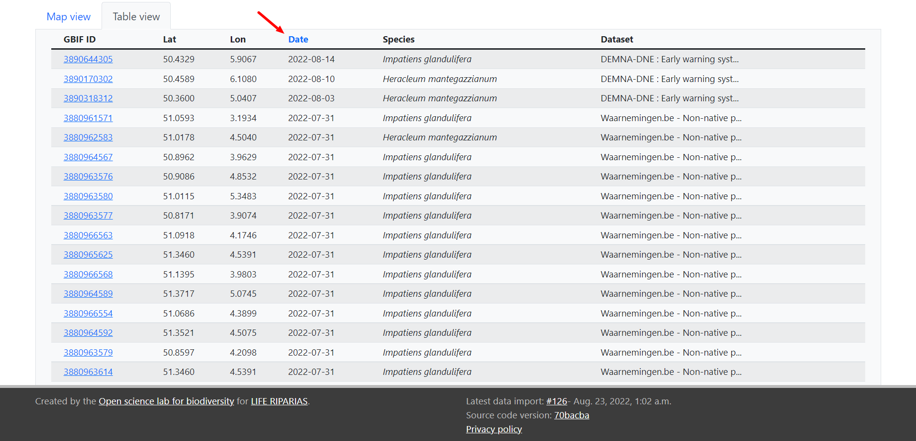
Homepage: Table view
Notes:
Observations ordered by default on Date (most recent first)
Click on another column to change order preference

Slide 15
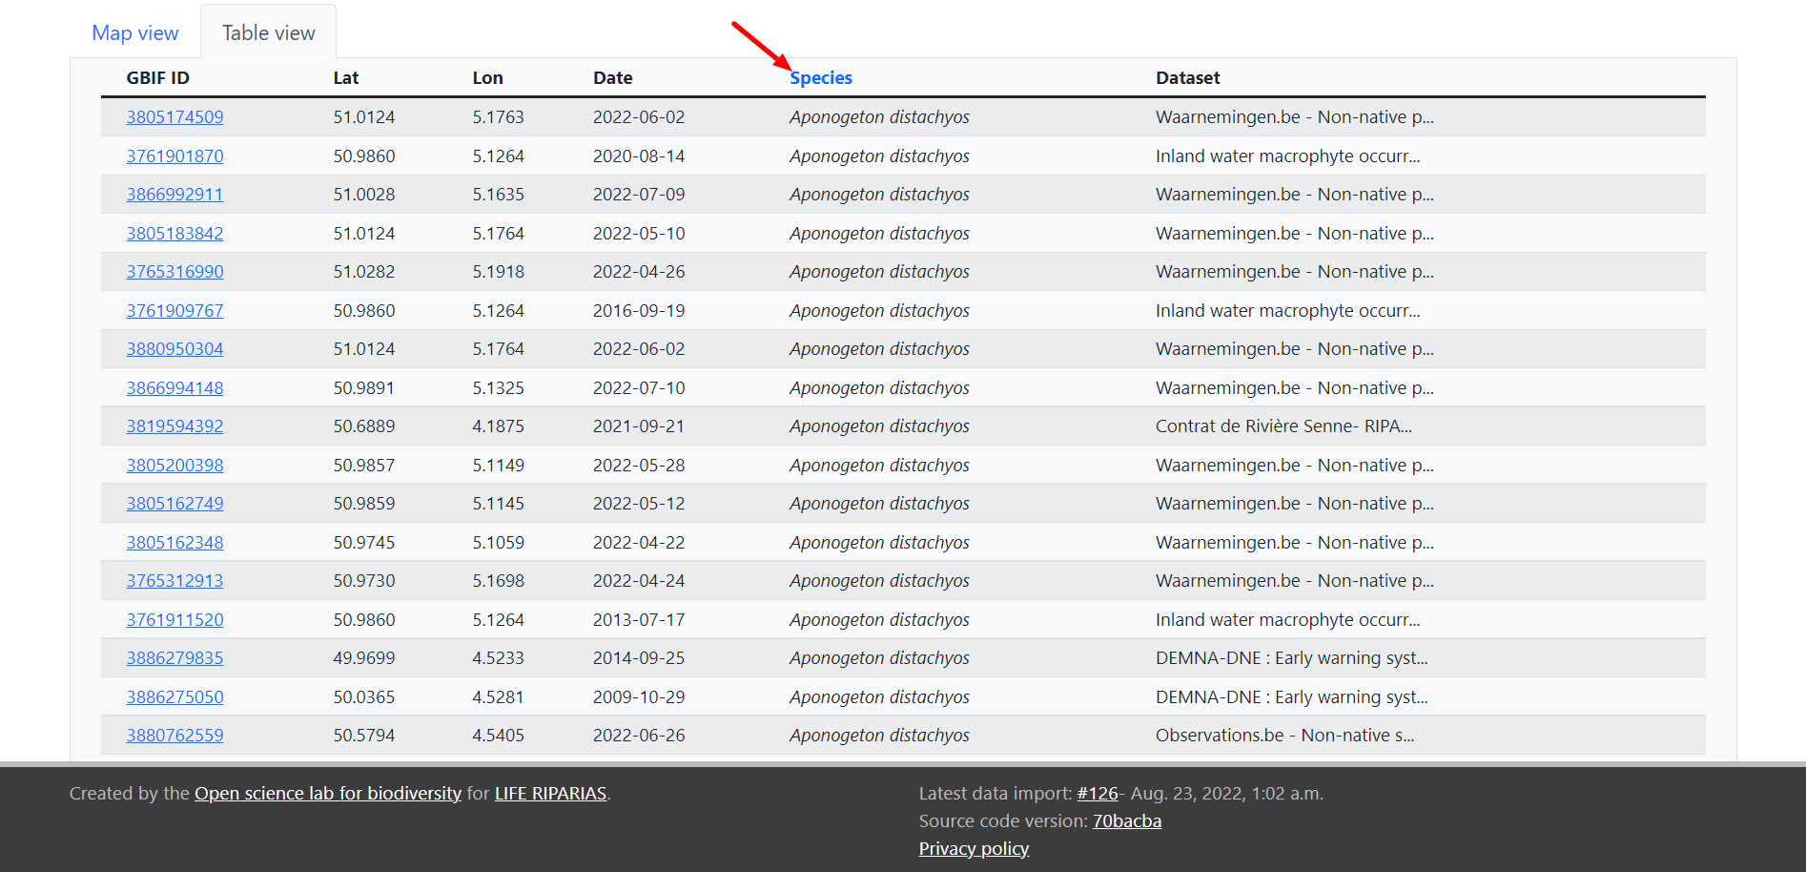
Homepage: Table view
Notes:
Observations ordered by default on Date (most recent first)
Click on another column to change order preference

Slide 16
Homepage: Filters
Filter by
Species: one or more LIFE RIPARIAS target list
Location: one or more LIFE RIPARIAS river basins, provinces or regions
Time: date of observation
Notes:
You can:
Observations ordered by default on Date (most recent first)
Click on another column to change order preference

Slide 17
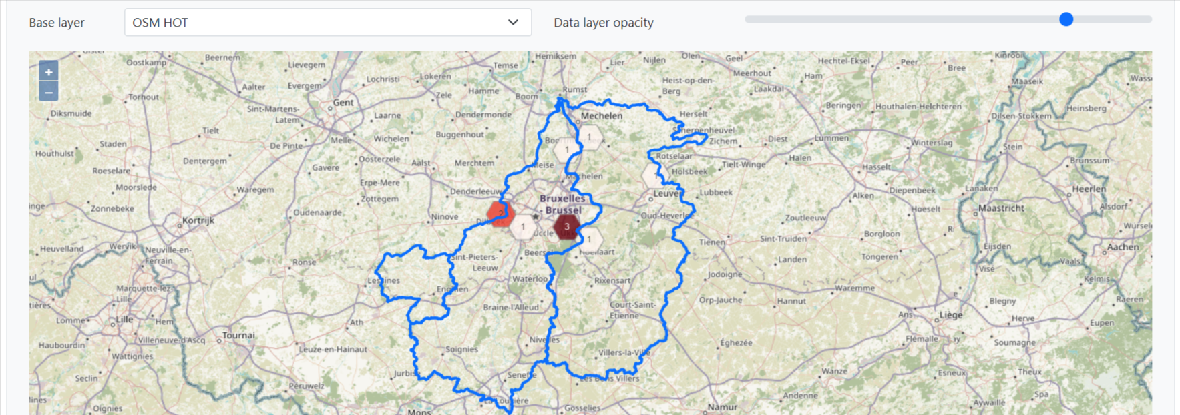
Homepage: Filters
Filter by
Species: one or more LIFE RIPARIAS target list
Location: one or more LIFE RIPARIAS river basins, provinces or regions
Time: date of observation
Notes:
In blu the borders of the selected locations, in this case the 3 target river basins of LIFE RIPARIAS.

Slide 18
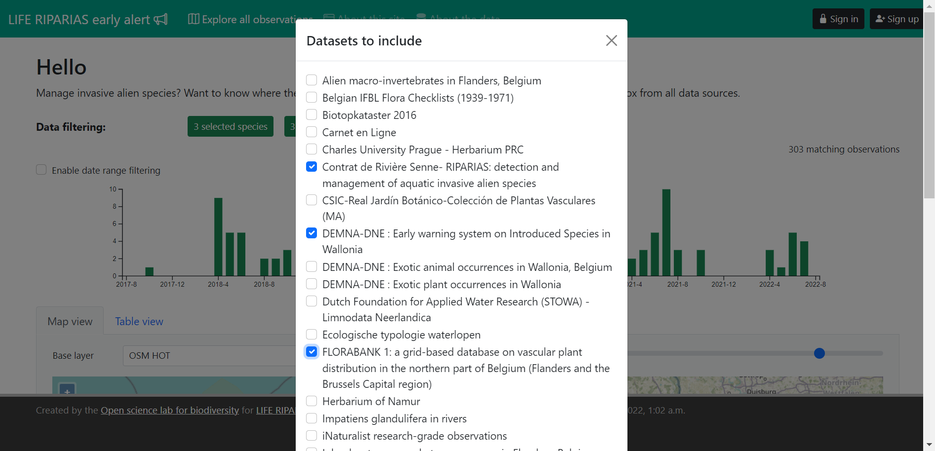
Homepage: Filters
Other filters:
Dataset: the dataset on GBIF the observations come from,
e.g. “Observations.be - Non-native species occurrences in Wallonia, Belgium”
Data import: when the observations were imported for the very first time
Notes:
“Other filters” are less important for the first-time user

Slide 19
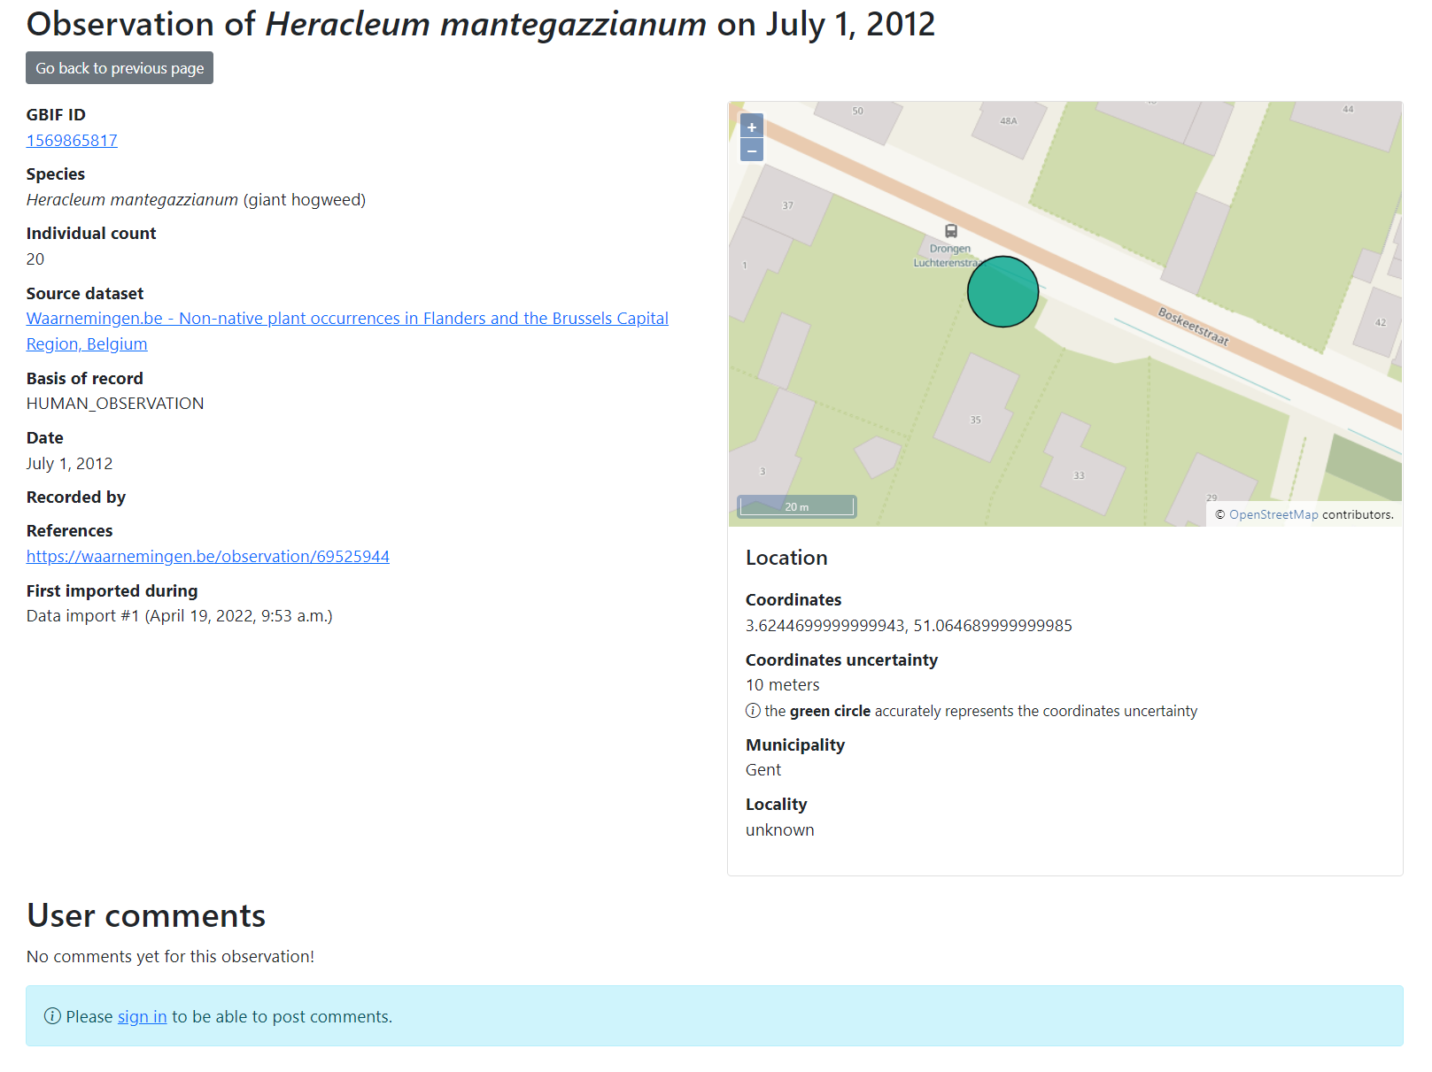
LIFE RIPARIAS early alert: observation page
GBIF ID: link to full observation on GBIF
Species: scientific name (vernacular name)
Individual count
Source dataset: link to GBIF dataset
Basis of record, type of record, e.g. HUMAN_OBSERVATION
Date of observation
Recorded by: recorder details
References: link to extra informations, e.g. observation page on waarnemingen.be
Map with location details: coordinates, municipality, coordinates uncertainty
User comments: you need to sign in to write a comment

Slide 20
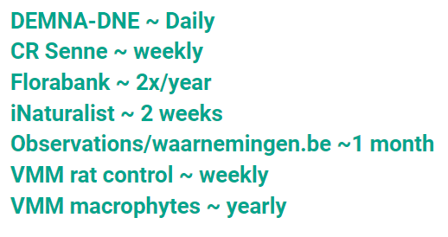
Future development
Increase the frequency of data publication on GBIF
Add media to GBIF (photos)
Integrate areas: river basins, protected areas, provinces, other management-relevant layers
Allow users to create their own locations (create polygon functionality)
Extend species list to the entire List of Invasive Alien Species of Union concern
Extend species list to the entire list of alien species of Belgium (GRIIS Belgium)
Add French and Dutch translations
User feedback is welcome! Contact us at info@alert.riparias.be
Share Your data, LIFE RIPARIAS can deliver support
Notes:
Extending species list to the entire List of Invasive Alien Species of Union concern will make this tool much more relevant at national level and so will increase its use even after the end of the project.

Slide 21
DEMO
Create Alert
alert.riparias.be

Slide 22
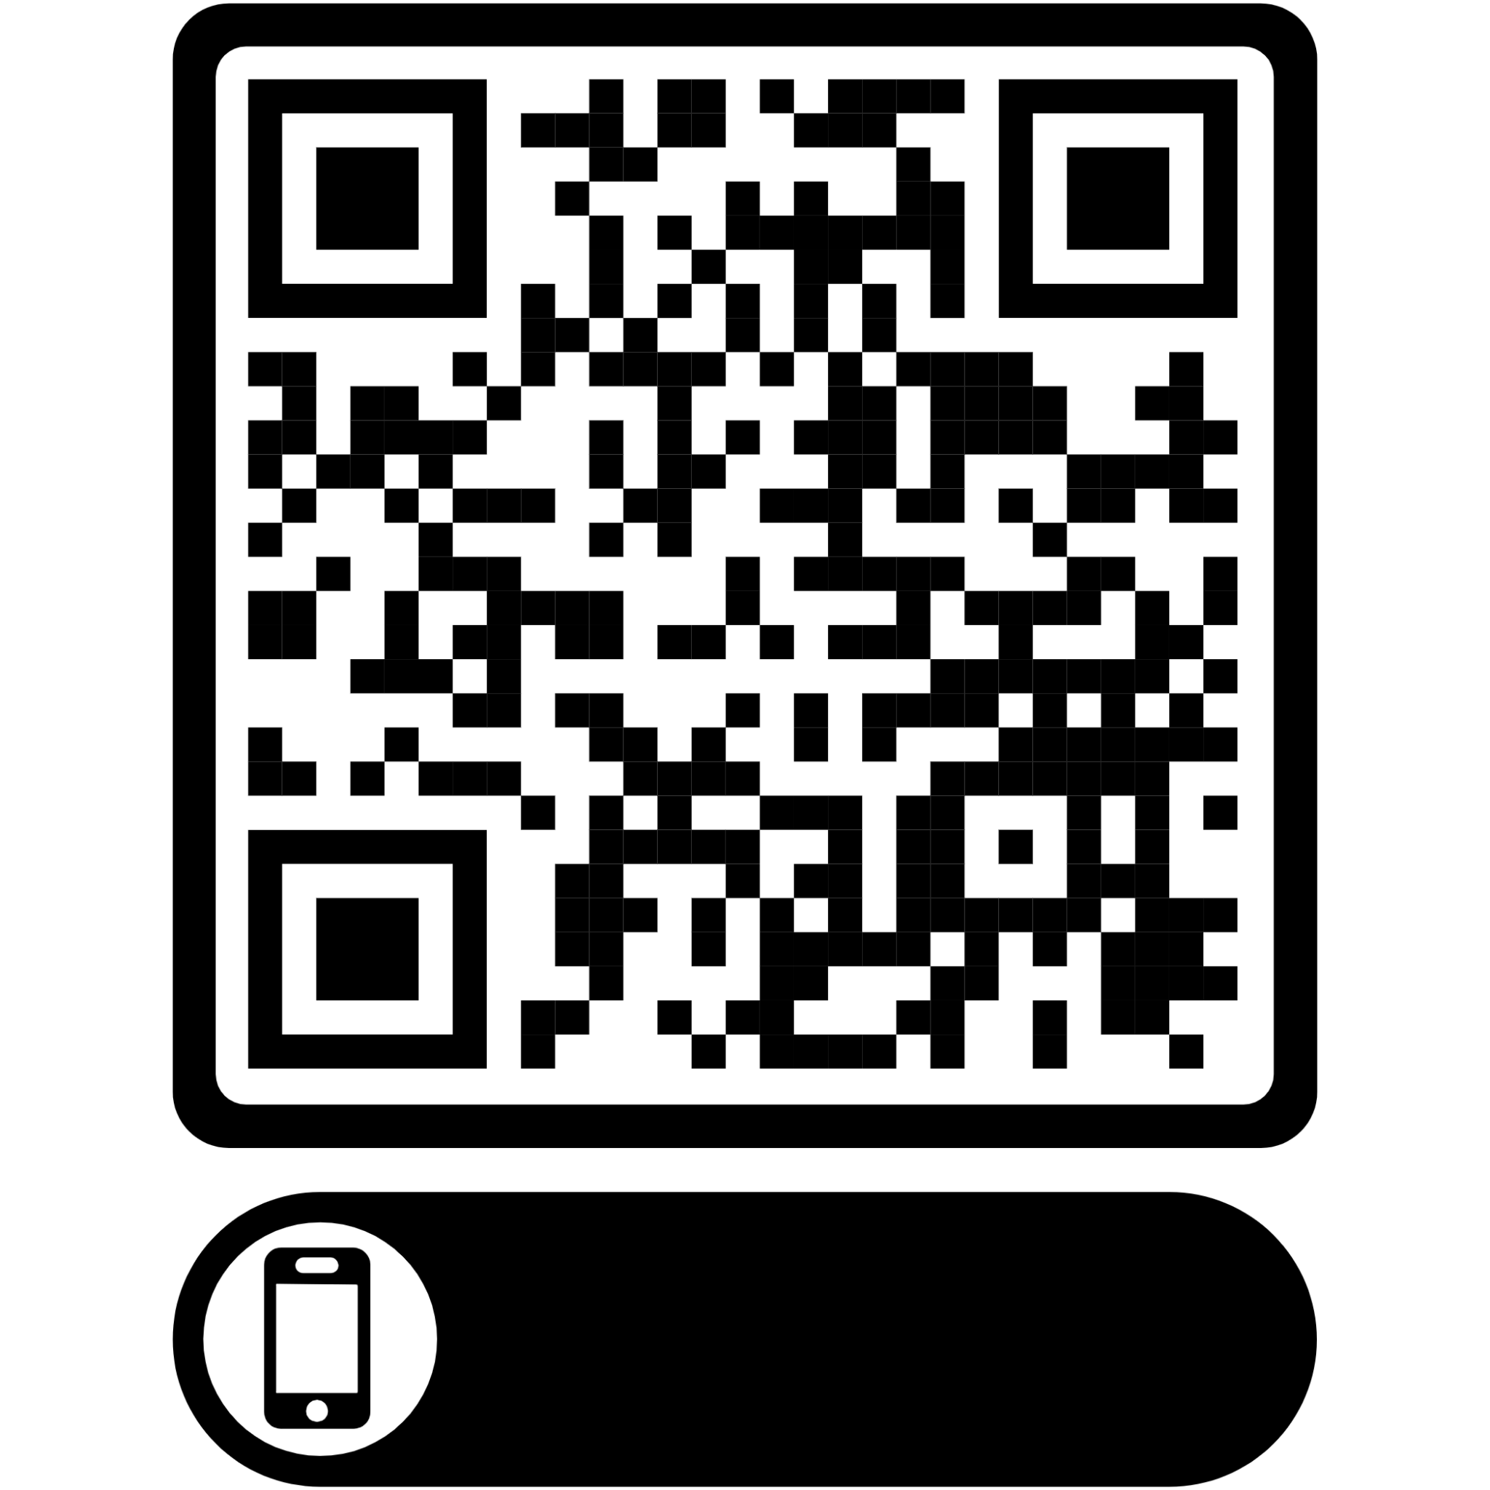
EXERCISE
You are a river basin manager active in the province of East Flanders. Create a customized alert for daily notification of observations of pigmyweed (Crassula helmsii) and floating pennywort (Hydrocotyle ranunculoides), based on data from Florabank, iNaturalist and waarnemingen.be
Notes:
Extending species list to the entire List of Invasive Alien Species of Union concern will make this tool much more relevant at national level and so will increase its use even after the end of the project.

Slide 23
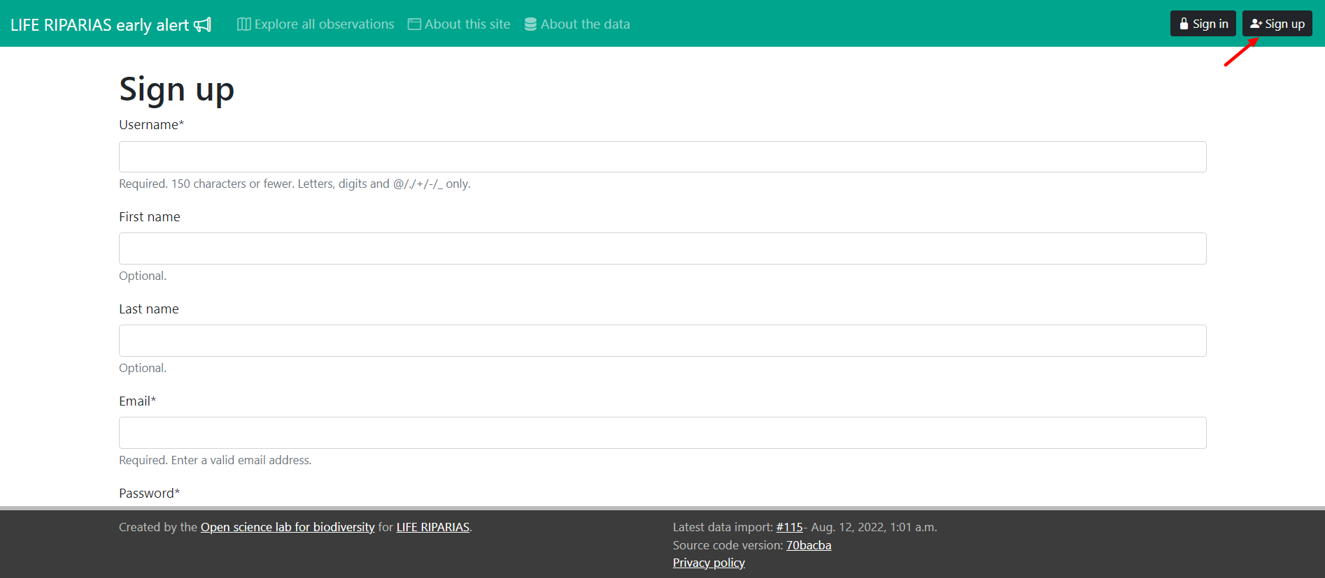
LIFE RIPARIAS early alert: sign in/ sign up
Set your own alerts by creating a new account

Slide 24
LIFE RIPARIAS early alert: after sign up
All observations are “unseen” to the user the very first time he/she logs in. You can “Mark all observations as seen”. It might take a while the first time…
Notes:
Refreshing the page after a while to see the progress of marking all as seen.

Slide 25
LIFE RIPARIAS early alert: create your alerts
Configure your alerts based on:
Species: one or more LIFE RIPARIAS target list
Areas: one or more LIFE RIPARIAS river basins, provinces or regions
Datasets: GBIF datasets observations belongs to
Email notifications frequency: daily, weekly, never, …
And explore matching observations
No limit on the number of alerts.

Slide 26
LIFE RIPARIAS early alert: seen-unseen observations
You can visualize all/seen/unseen observations in both Map View and Table View
Notes:
Example: alert about new observations (all species) in West Flanders

Slide 27
LIFE RIPARIAS early alert: seen-unseen observations
You can visualize all/seen/unseen observations in both map View and Table View
Seen observations can be flagged back as unseen on observation page at any time

Slide 28
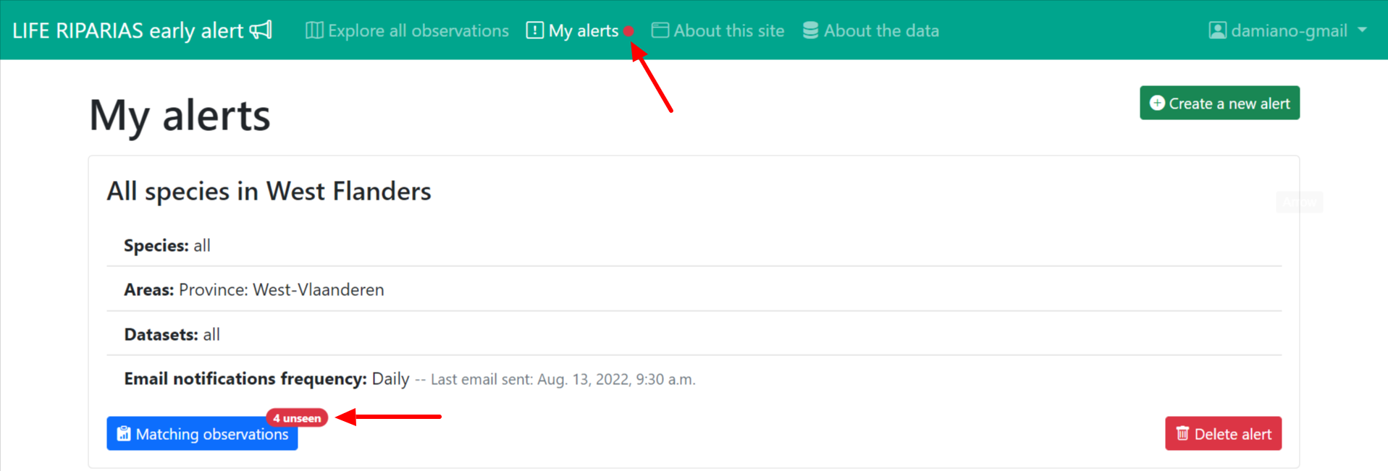
LIFE RIPARIAS early alert: seen-unseen observations
You can visualize all/seen/unseen observations in both map View and Table View
Seen observations can be changed back to unseen on observation page
You are visually notified if unseen observations are matching your alerts

Slide 29
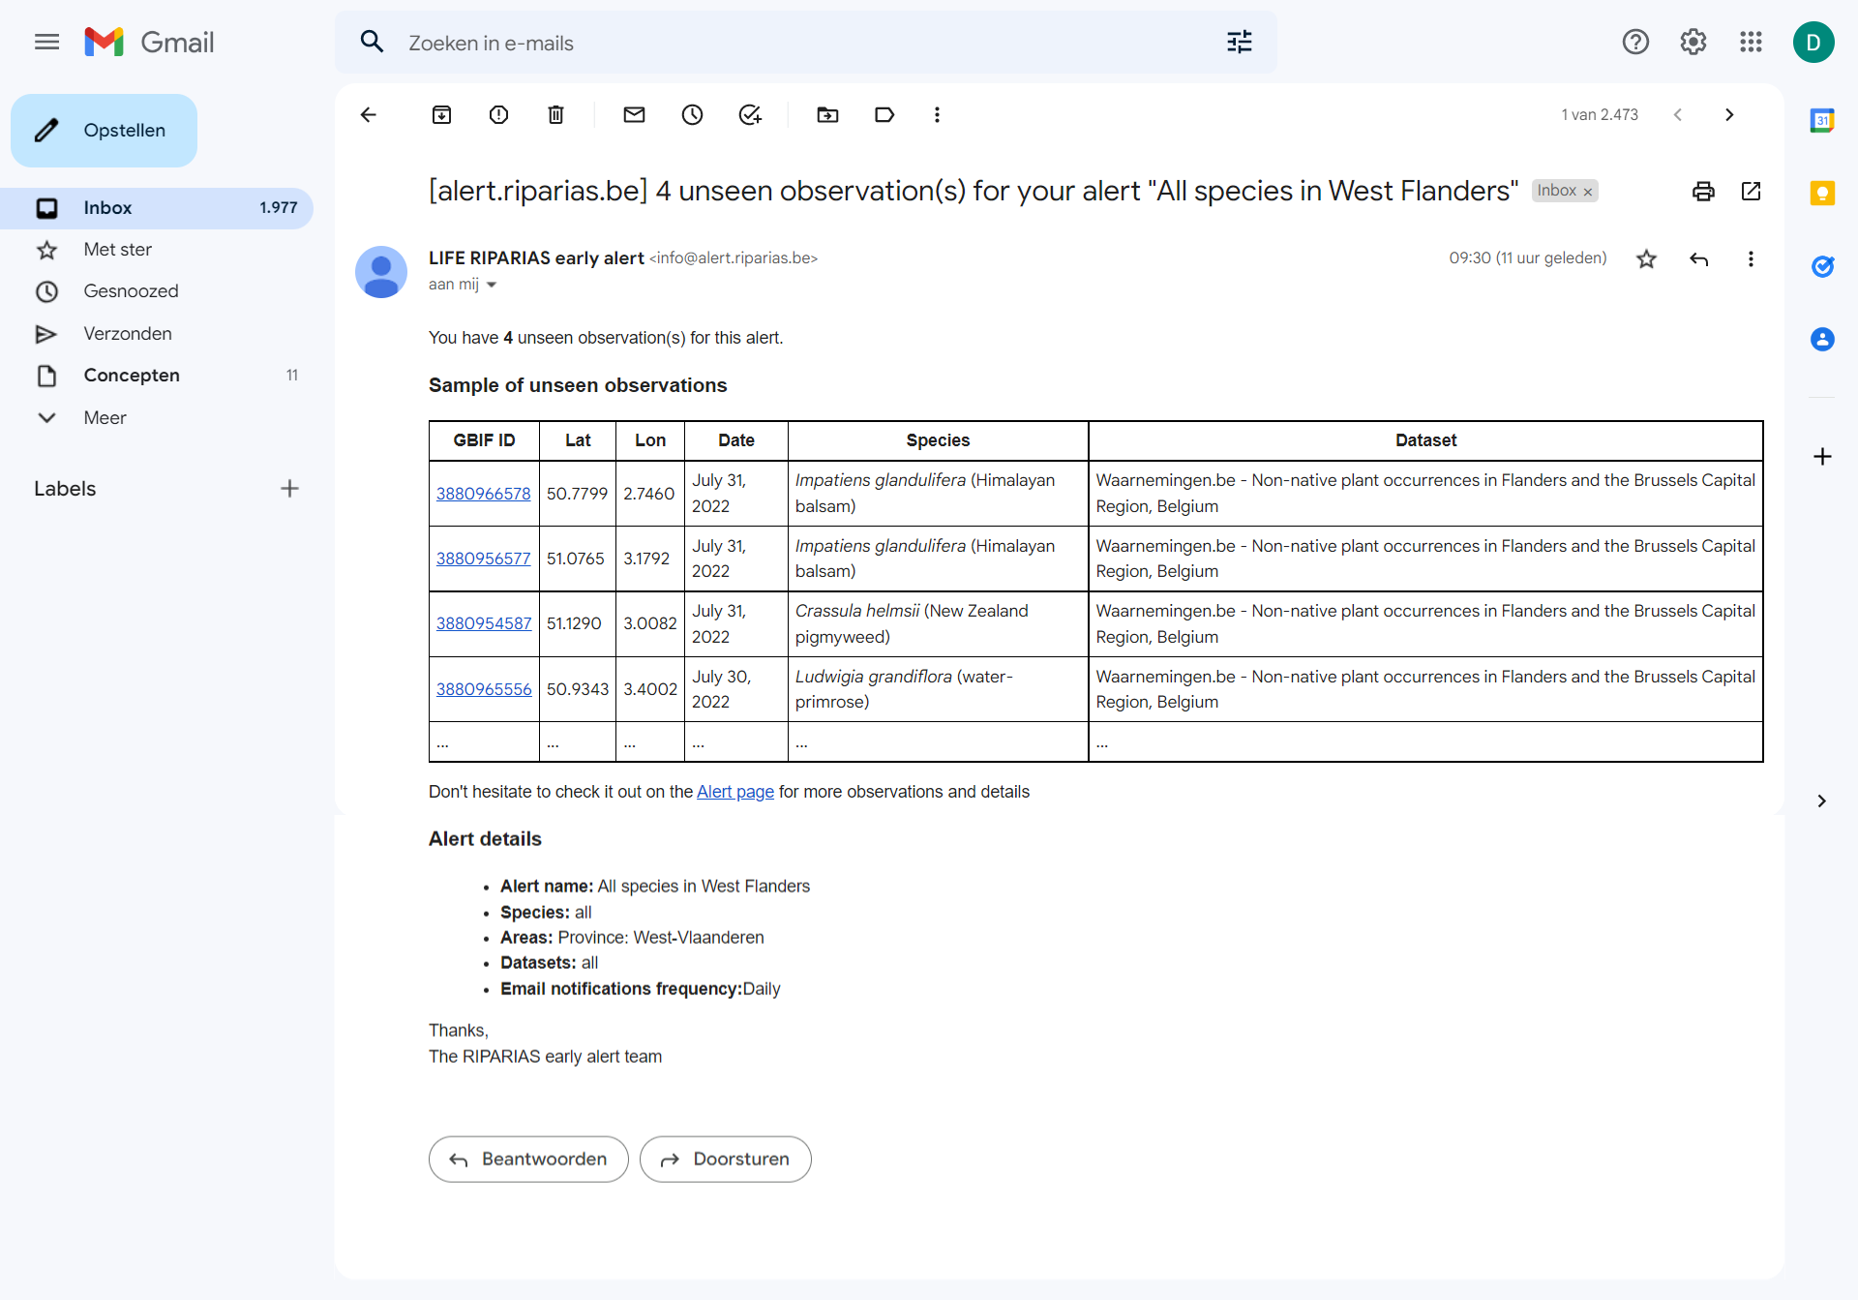
LIFE RIPARIAS early alert: mail notifications
Notes:
Mail subject: xx unseen observations for your alert “name of the alert”.
Mail body:
sentence: “You have xx unseen observation(s) for this alert.”
Sample of the unseen observations (max 10)
Sentence with link to the Alert page
Alert details
Signature

Slide 30
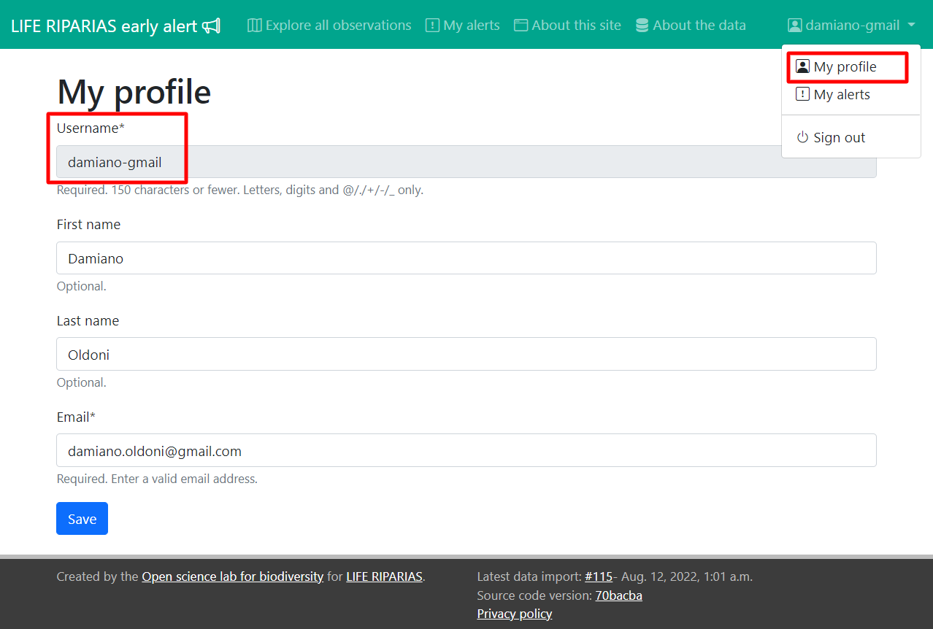
LIFE RIPARIAS early alert: my profile
Configure your contact details:
first name
last name
email (important for notifications).
Username cannot be changed.

Slide 31
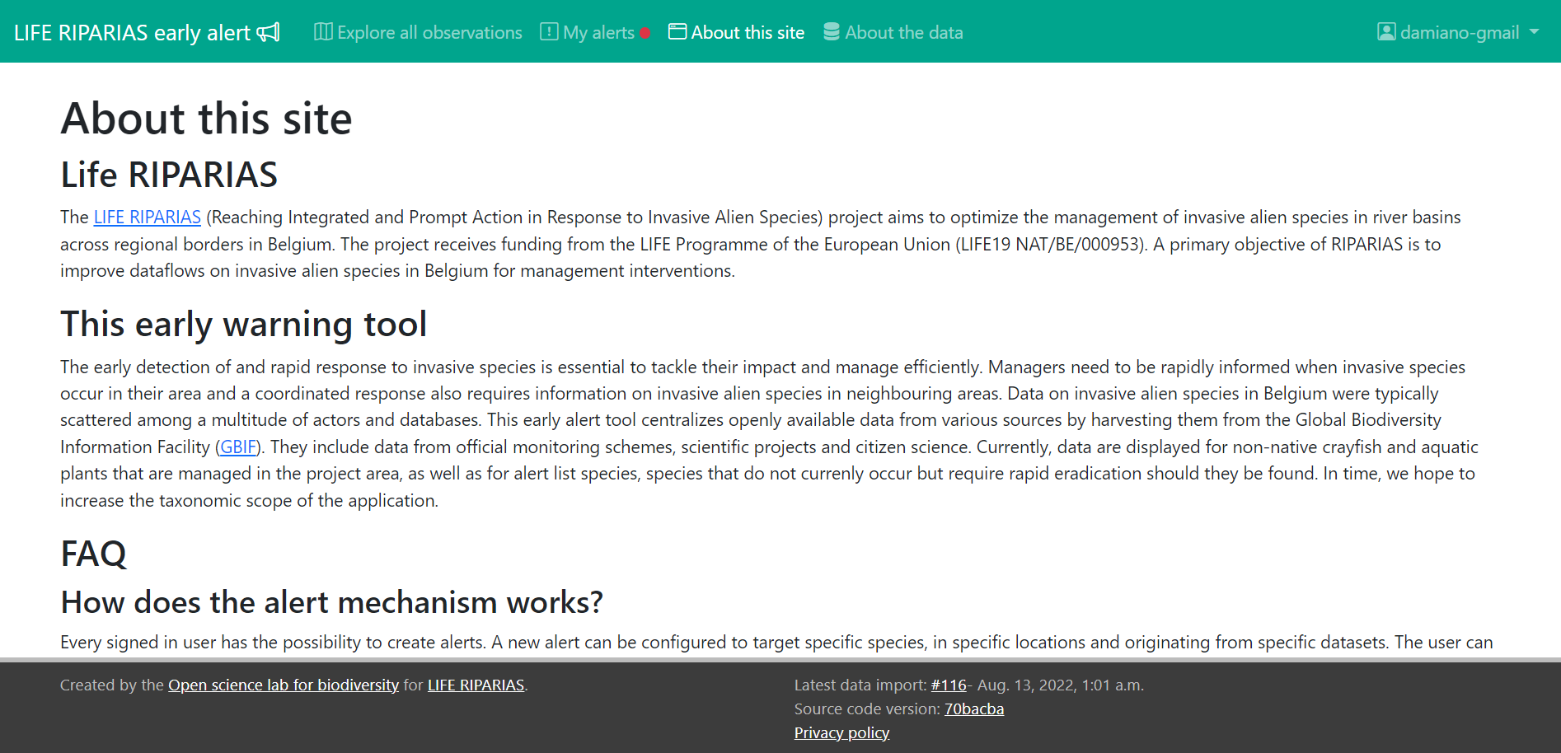
https://alert.riparias.be/about-site
LIFE RIPARIAS early alert: more info
Please give a look to the “About this site” page (https://alert.riparias.be/about-site)
Notes:
Extending species list to the entire List of Invasive Alien Species of Union concern will make this tool much more relevant and so will also improve its use even after the end of the project.

