Slide 1
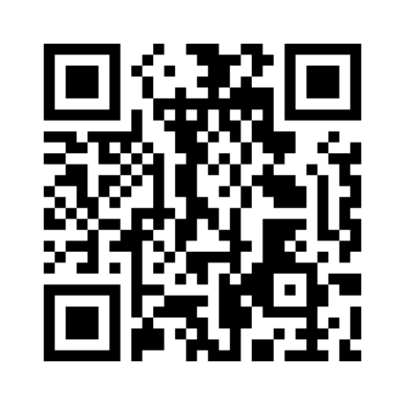
Workshop Digitalisering
Praktijkdag Exotenbeheer
www.menti.com
Access code 2362 7547

Slide 2
LIFE RIPARIAS early alert tool
alert.riparias.be

Slide 3
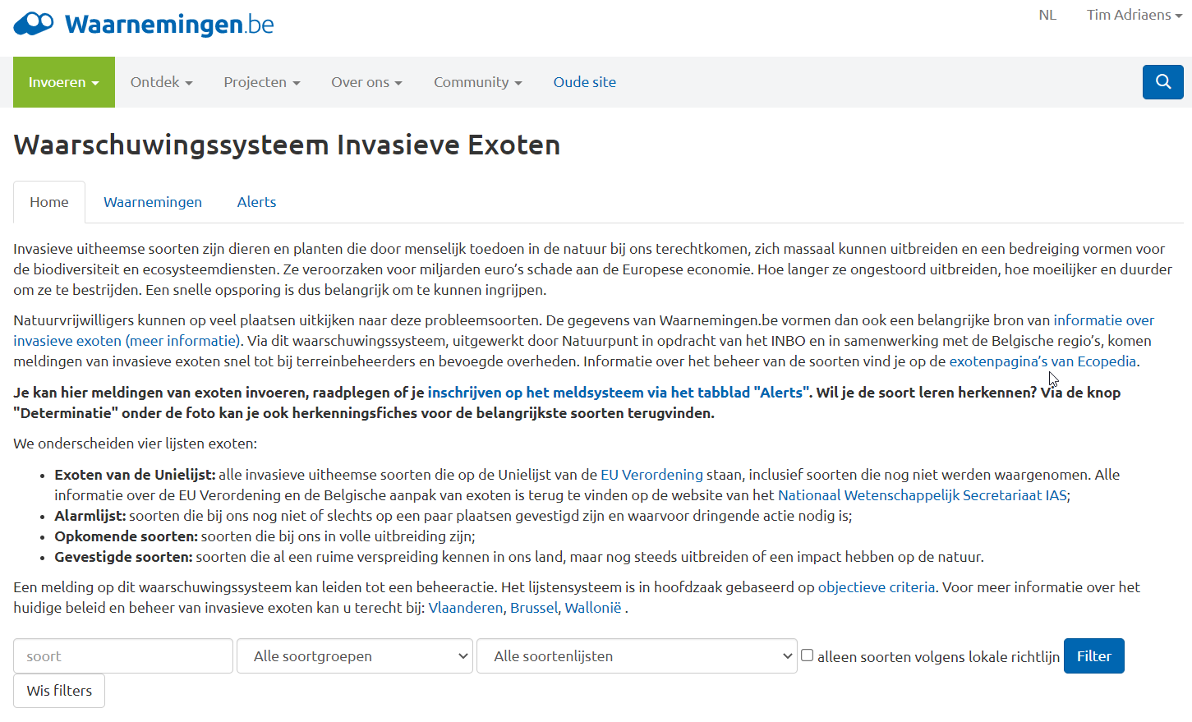
The current early warning system
Notes:
What is the LIFE RIPARIAS early alert? It’s a WEB APPLICATION.That means it is a software that has a website as “end product” (front-end in the computer science jargon) the user interacts with.

Slide 4
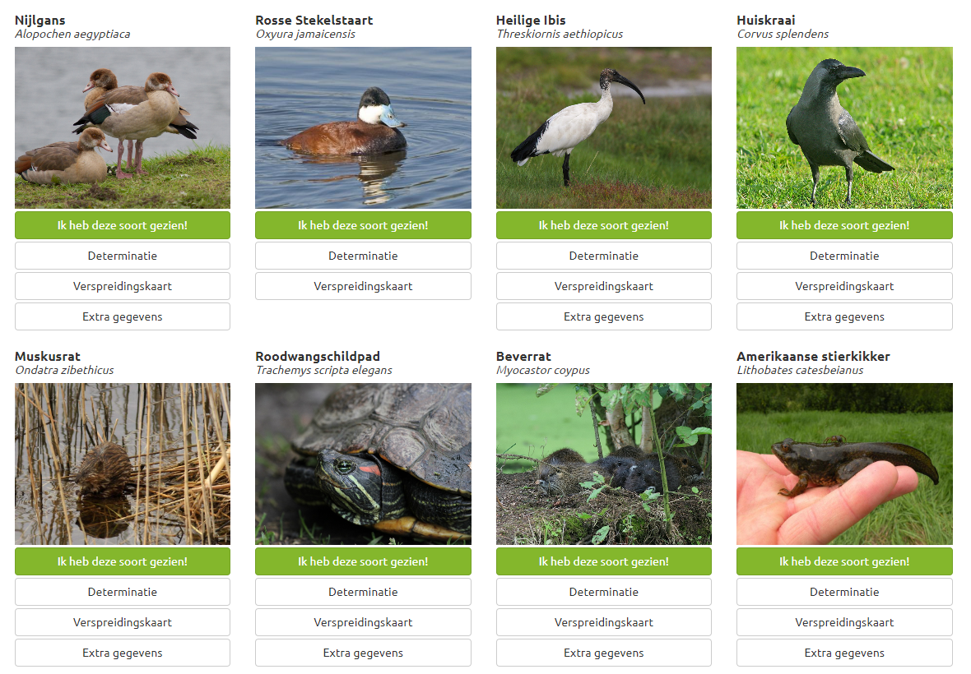
The current early warning system
Single-datasource: waarnemingen.be (citizen science)
Individual species alerts
Batch species alerts:
Union List species
(3rd update)
Emerging aliens (ISEIA)
Established aliens (ISEIA)
Alert list aliens
ISEIA
DUNIAS alert list
Notes:
What is the LIFE RIPARIAS early alert? It’s a WEB APPLICATION.That means it is a software that has a website as “end product” (front-end in the computer science jargon) the user interacts with.

Slide 5
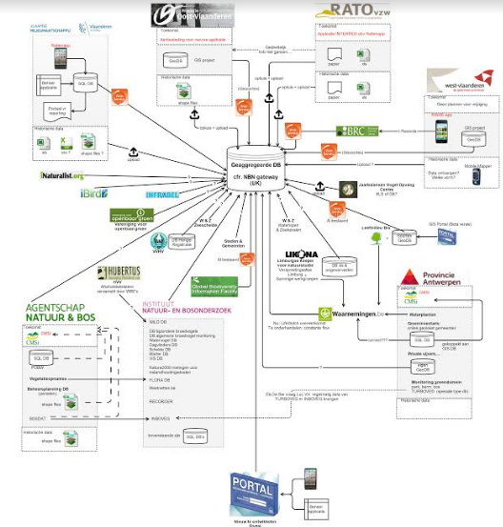
What about the other data sources

Slide 6
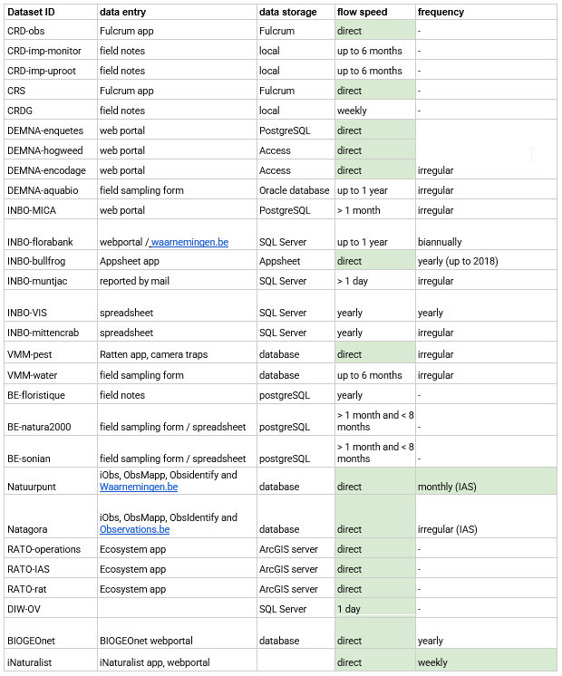
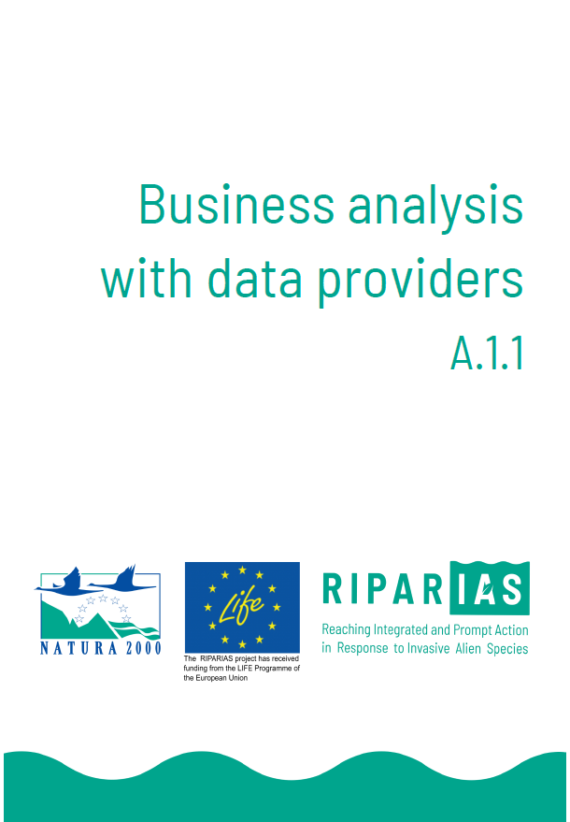
Other data sources

Slide 7
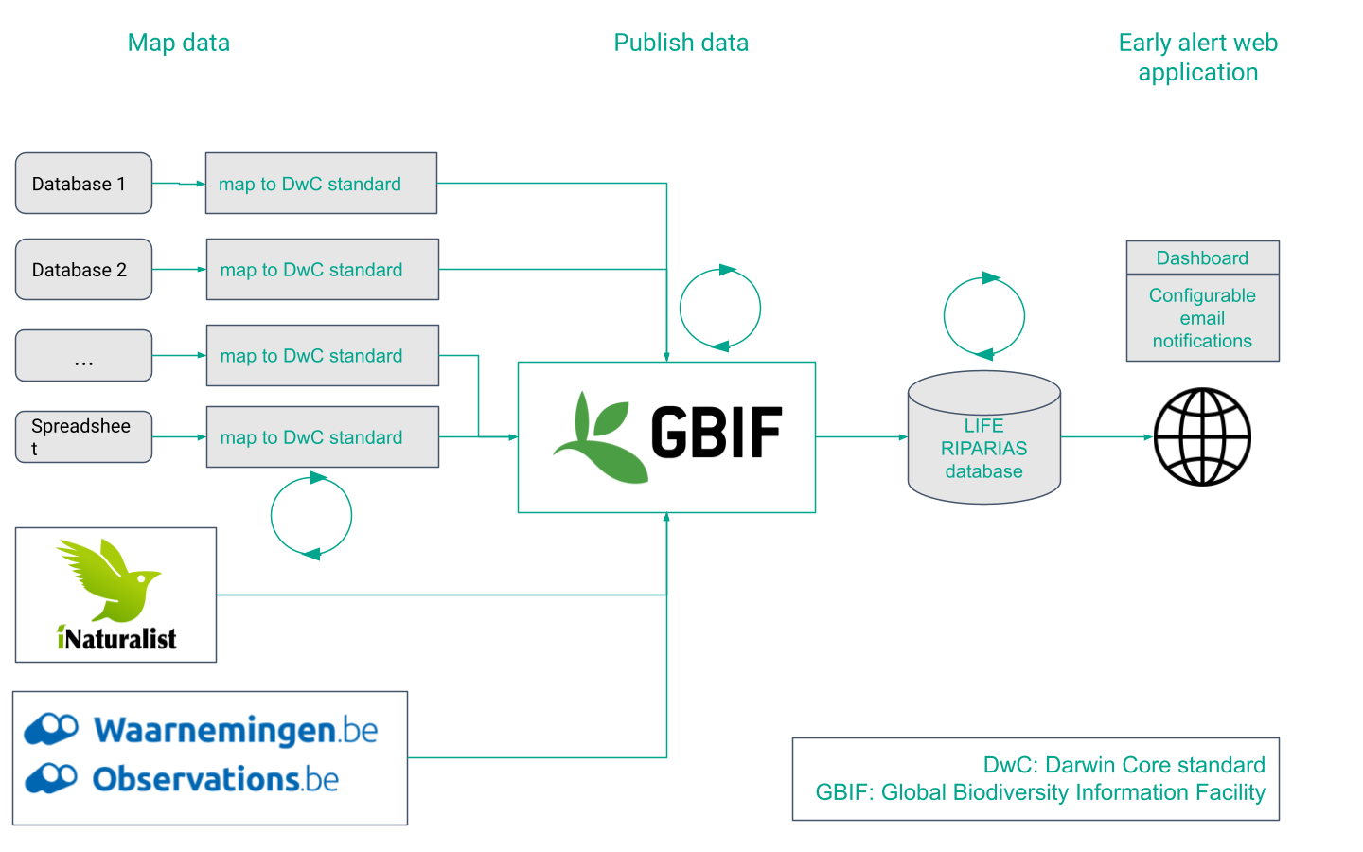
LIFE RIPARIAS early alert: the data workflow
Notes:
So, it’s very important that as many observations as possible are published on GBIF. Otherwise the early alert will be a nice tool but not really interesting for a field manager.

Slide 8
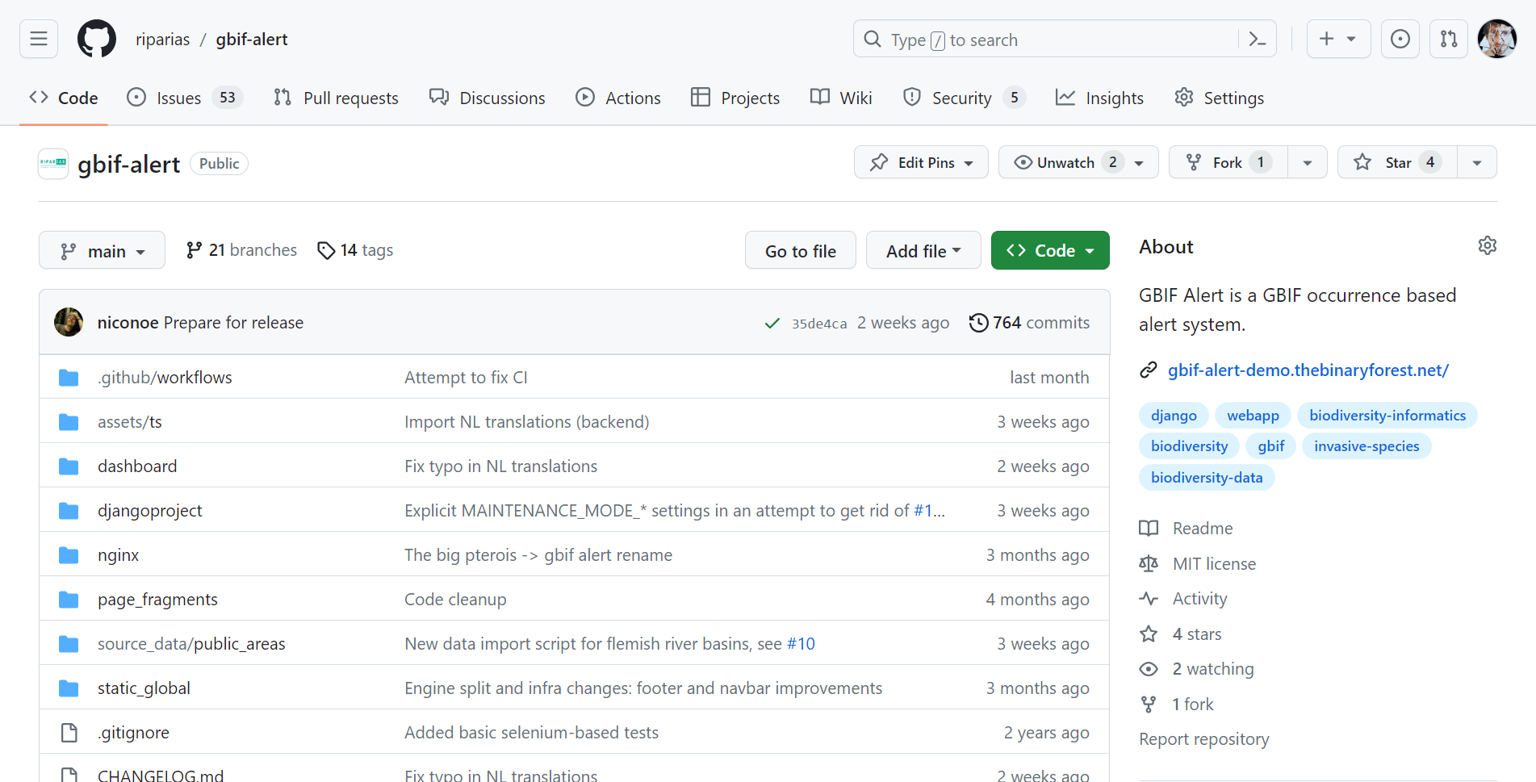
GBIF Alert: what is it?
GBIF Alert is a reusable website engine to:
Monitor a (list of) species
Be notified of new occurrences on GBIF via email
Build multiple websites (called instances) to target different communities.
LIFE RIPARIAS early alert is an instance of GBIF Alert
Notes:
What is the LIFE RIPARIAS early alert? It’s a WEB APPLICATION.That means it is a software that has a website as “end product” (front-end in the computer science jargon) the user interacts with.

Slide 9
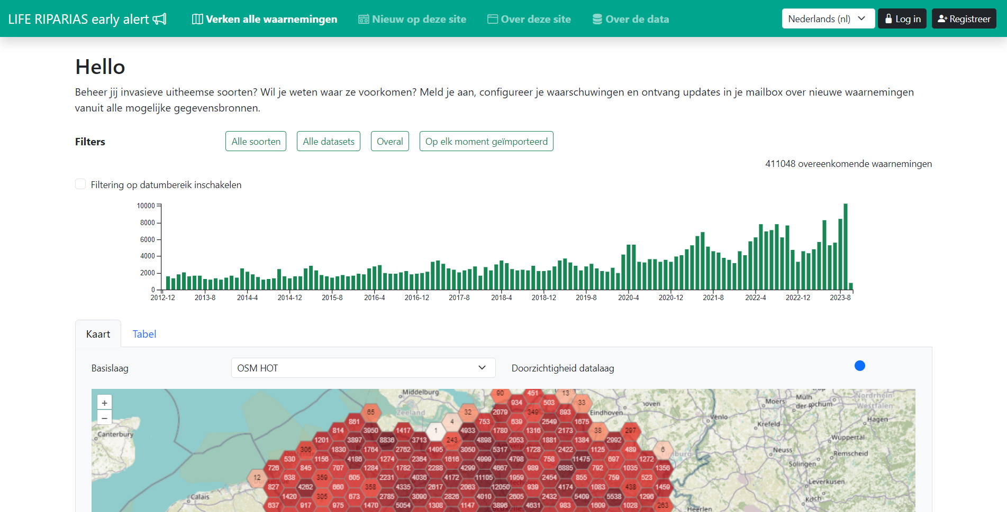
LIFE RIPARIAS early alert: web application
Notes:
What is the LIFE RIPARIAS early alert? It’s a WEB APPLICATION.That means it is a software that has a website as “end product” (front-end in the computer science jargon) the user interacts with.

Slide 10
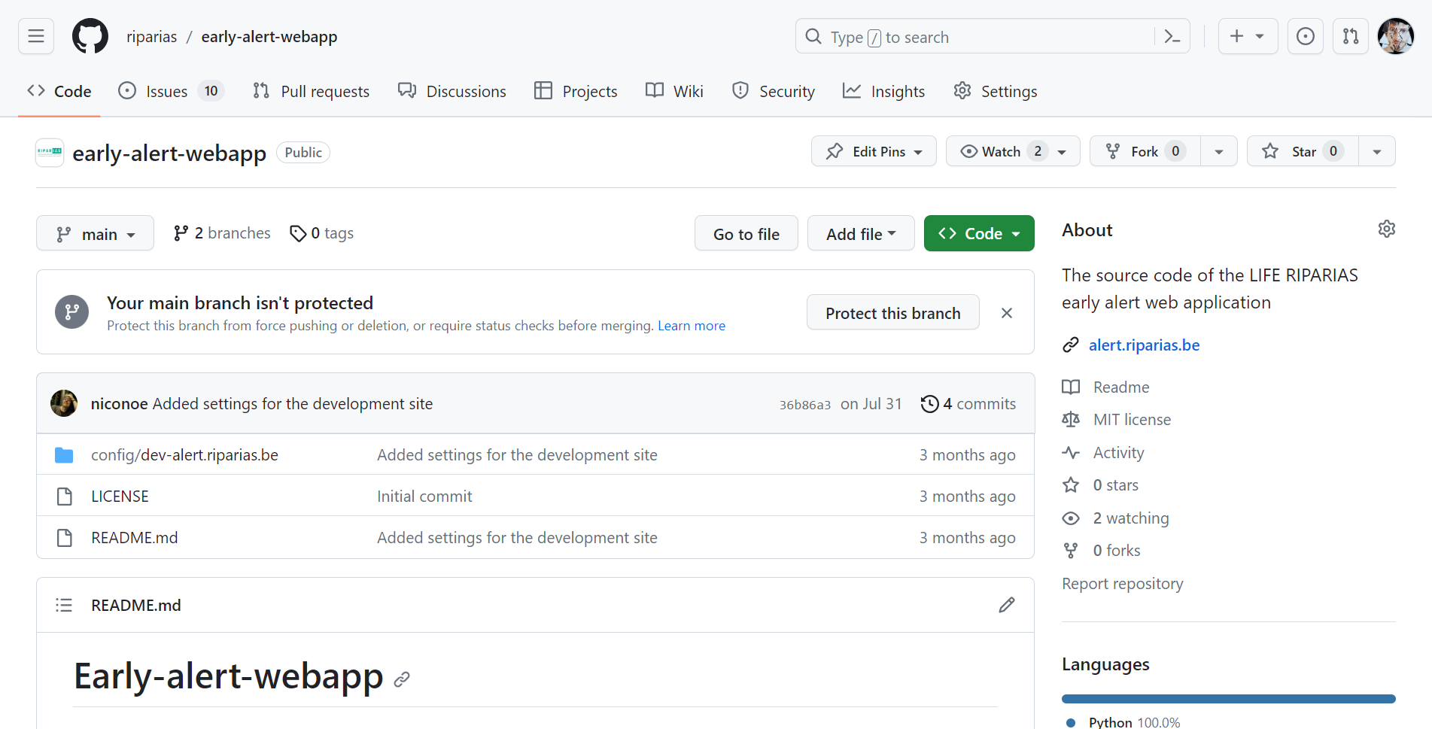
LIFE RIPARIAS early alert: web application
Open software: developed by Nicolas Noé with contributions of the Open science lab for biodiversity (INBO)

Slide 11
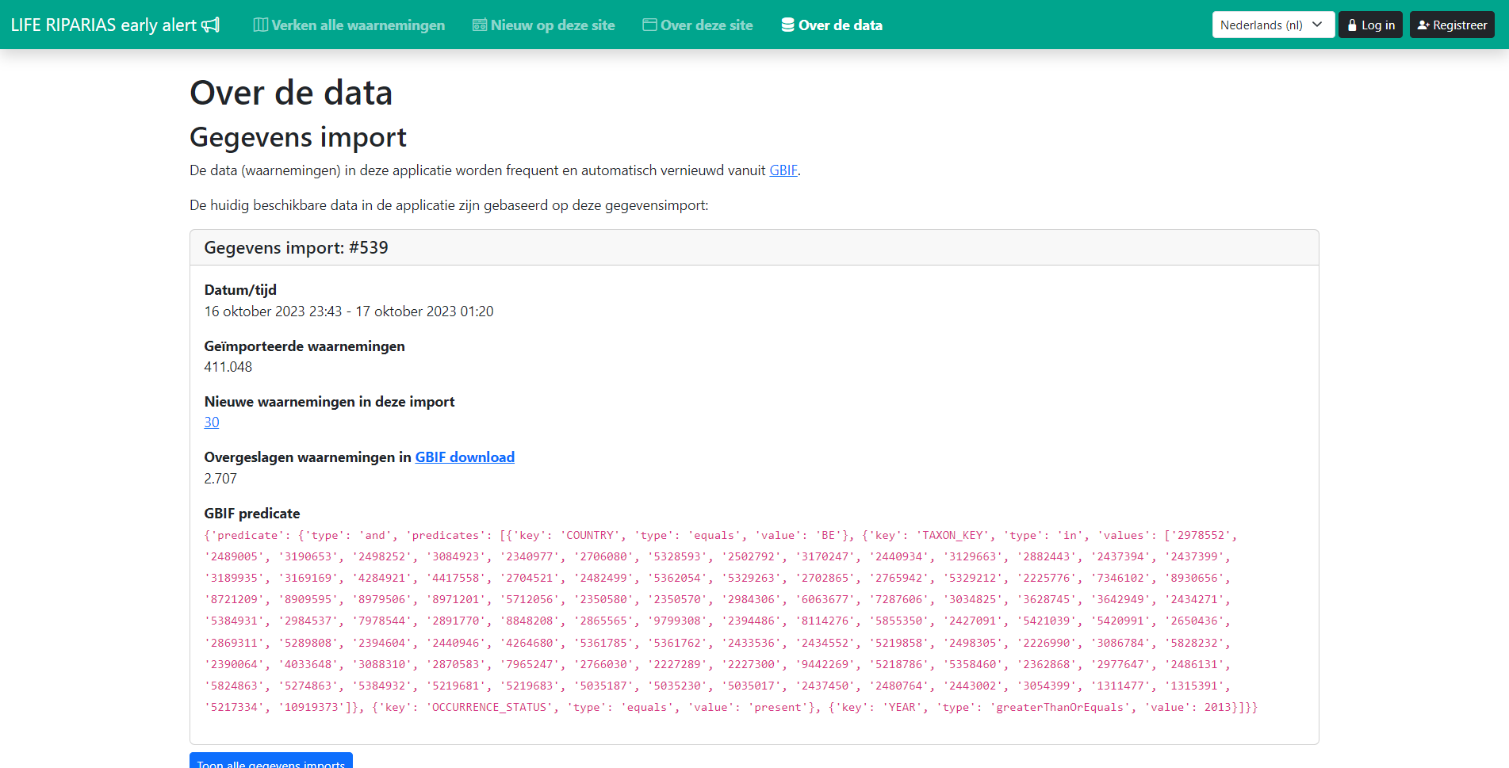
LIFE RIPARIAS early alert: about the data
GBIF-based: ALL data shown are imported daily from the Global Biodiversity Information Facility (GBIF)
Notes:
Import of data from GBIF is done every night

Slide 12
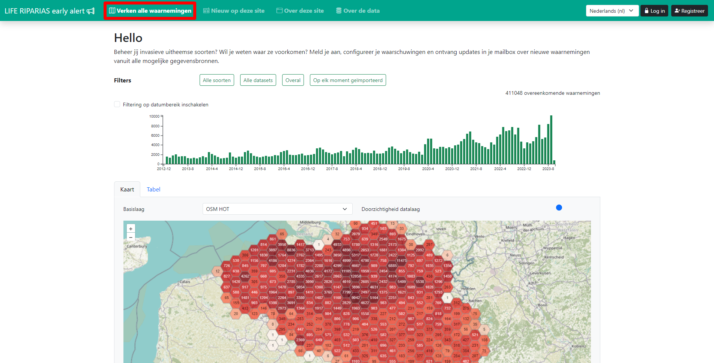
Homepage: explore observations
Notes:
No need to sign in.

Slide 13
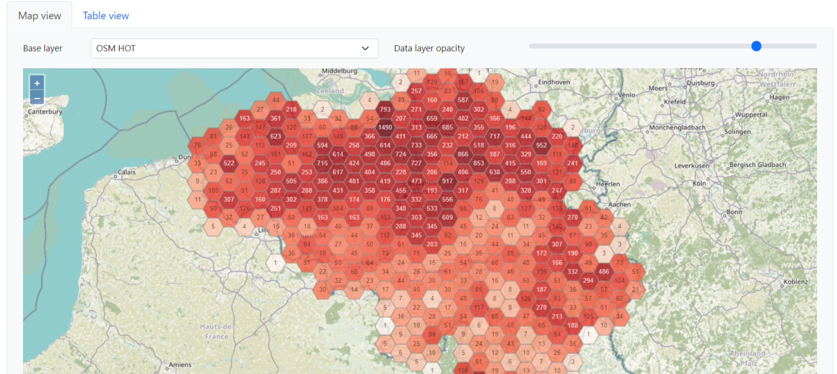
Homepage: Map view (default)
Notes:
You can:
switch among three different background maps
change the data layer opacity
Zoom in up to the level of single observations

Slide 14
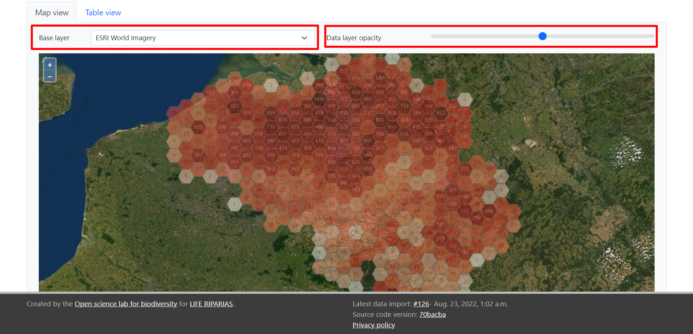
Homepage: Map view (default)
Notes:
You can:
switch among three different background maps
change the data layer opacity
Zoom in up to the level of single observations

Slide 15
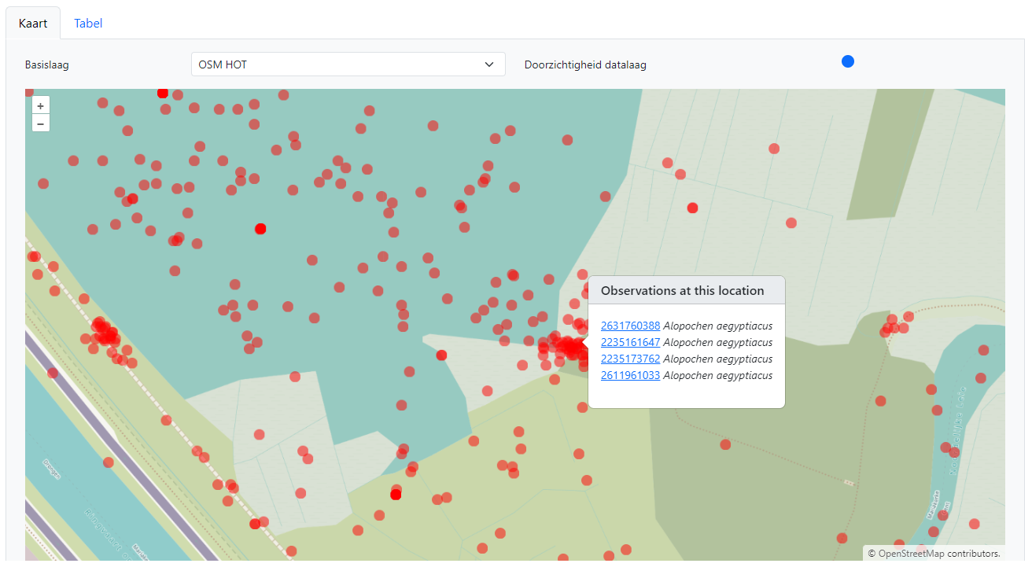
Homepage: Map view (default)
Notes:
You can:
switch among three different background maps
change the data layer opacity
Zoom in up to the level of single observations

Slide 16
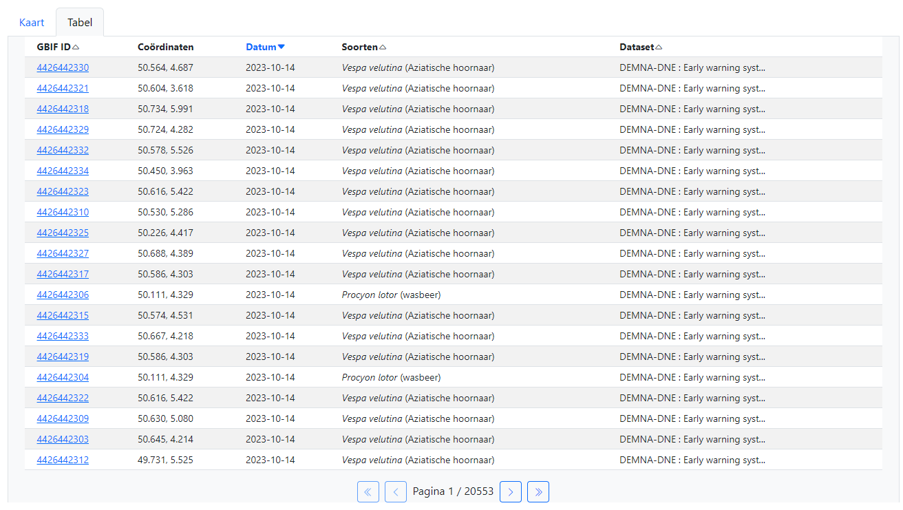
Homepage: Table view
Notes:
Observations ordered by default on Date (most recent first)
Click on another column to change order preference

Slide 17
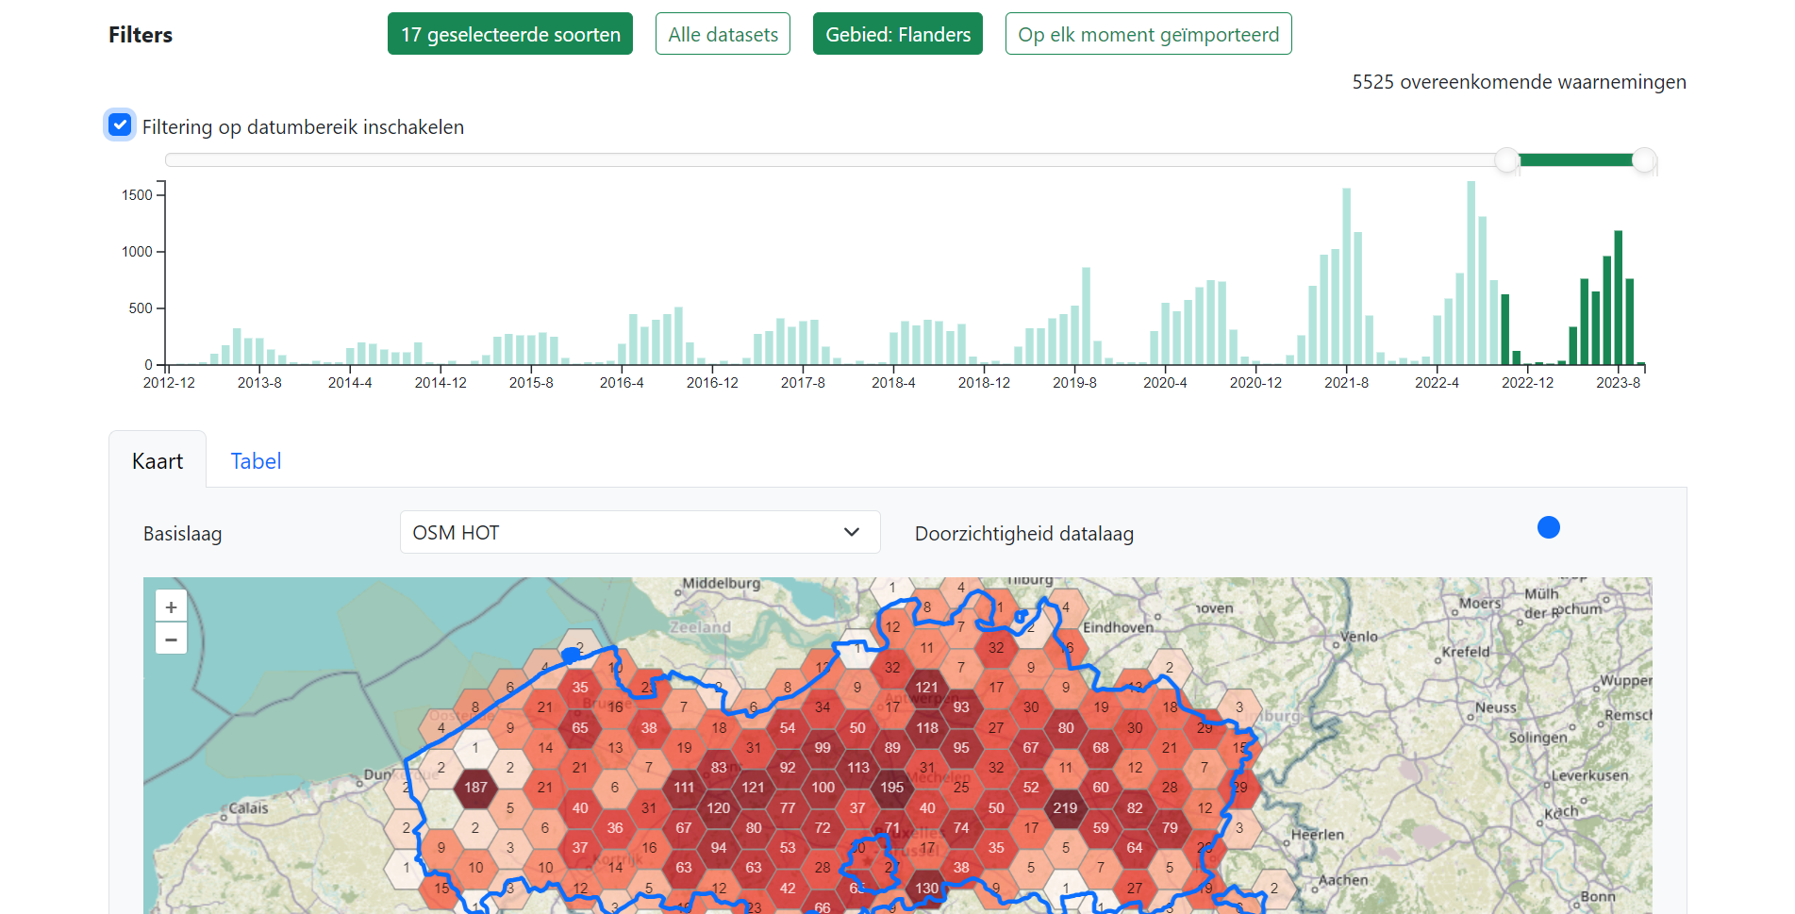
Homepage: Filters
Filter by
Species: one or more species from the LIFE RIPARIAS target list and the Union list
Location: one or more LIFE RIPARIAS river basins, Flemish river basins, provinces, regions, Natura2000, …
Time: date of observation (by enabling the data range filtering)
Notes:
You can:
Observations ordered by default on Date (most recent first)
Click on another column to change order preference

Slide 18
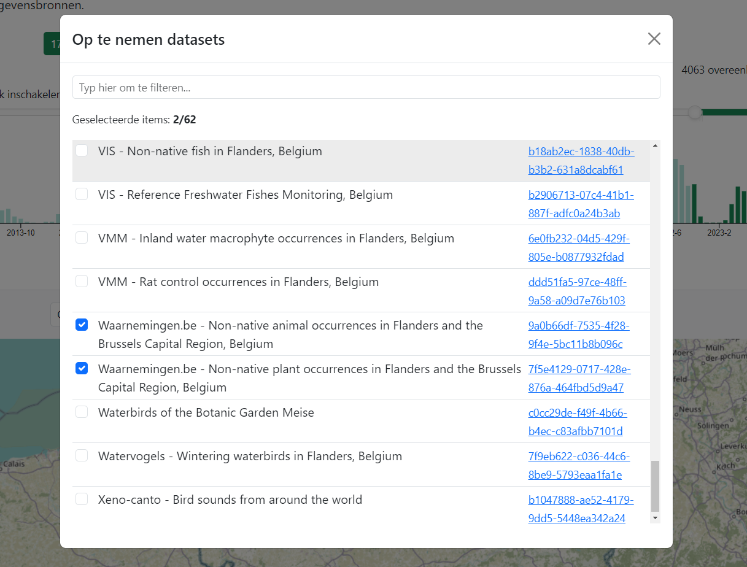
Homepage: Filters
Other filters:
Dataset: the dataset on GBIF the observations come from,
e.g. “waarnemingen.be - non native animal and plant occurrences”
Data import: when the observations were imported for the very first time
Notes:
“Other filters” are less important for the first-time user

Slide 19
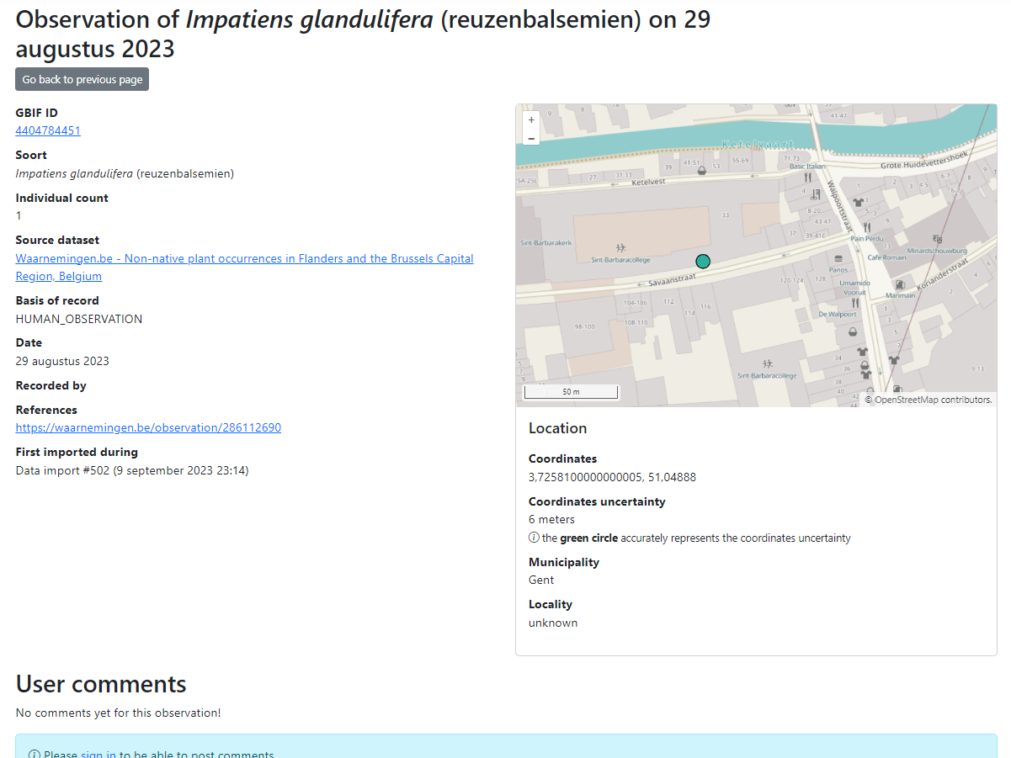
LIFE RIPARIAS early alert: observation page
GBIF ID: link to full observation on GBIF
Species: scientific name (vernacular name)
Individual count
Source dataset: link to GBIF dataset
Basis of record, type of record, e.g. HUMAN_OBSERVATION
Date of observation
Recorded by: recorder details
References: link to extra informations, e.g. observation page on waarnemingen.be
Map with location details: coordinates, municipality, coordinates uncertainty
User comments: you need to sign in to write a comment

Slide 20
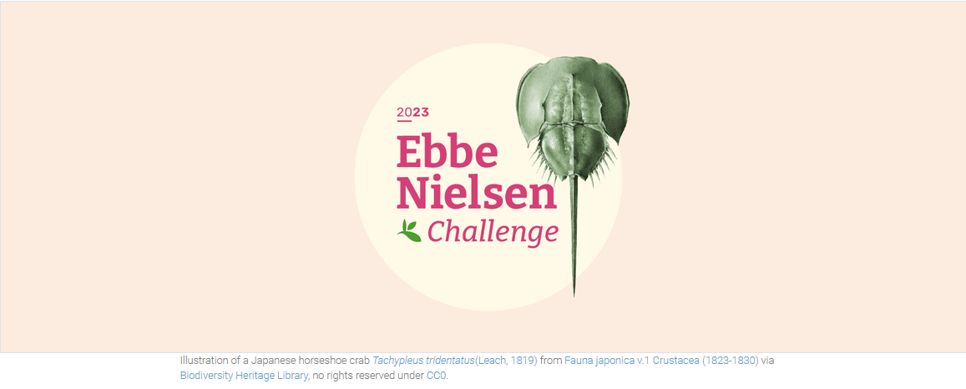
Award winning application
GBIF – Alert has won the 1st prize of the Ebbe Nielsen Challenge 2023: official release follows
Notes:
Extending species list to the entire List of Invasive Alien Species of Union concern will make this tool much more relevant at national level and so will increase its use even after the end of the project.

Slide 21
Future development
The web application is slow: upscale the database
Add more areas to filter: Wallonian river basins, others?
Extend species list to the entire list of alien species of Belgium (GRIIS Belgium, ~ 3900 species)?
User feedback is welcome! Contact us at info@alert.riparias.be
Share Your data, LIFE RIPARIAS can deliver support
Notes:
Extending species list to the entire List of Invasive Alien Species of Union concern will make this tool much more relevant at national level and so will increase its use even after the end of the project.

Slide 22
DEMO
Create an Alert

Slide 23
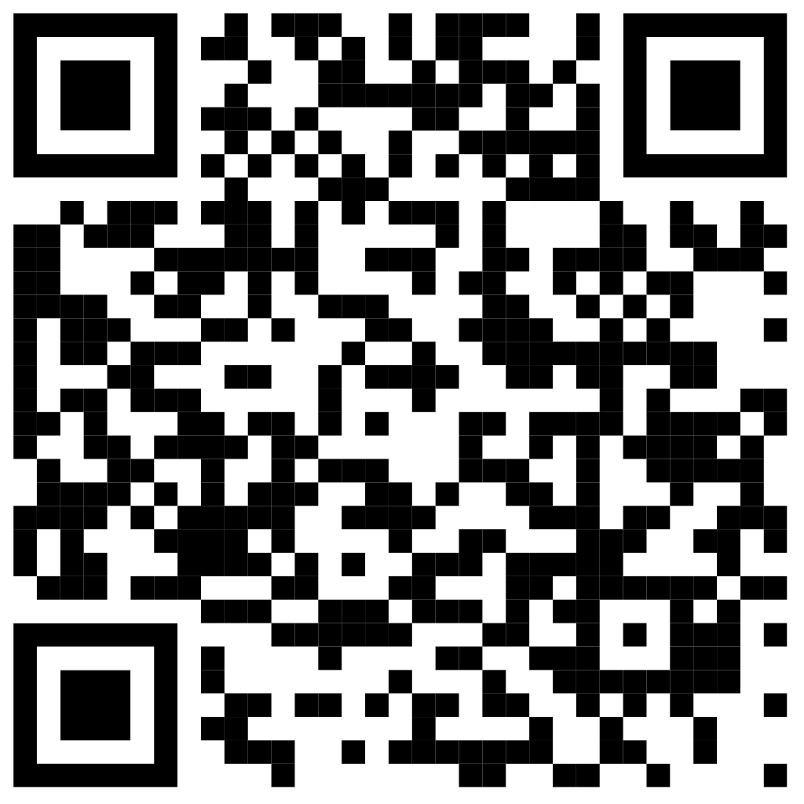
Oefening
Je bent waterbeheerder in de provincie Oost-Vlaanderen. Maak een alert aan voor dagelijkse waarschuwingen over nieuwe observaties van watercrassula (Crassula helmsii) en grote waternavel (Hydrocotyle ranunculoides). Je wil enkel data van Florabank, iNaturalist en waarnemingen.be binnenkrijgen.
alert.riparias.be
Notes:
Extending species list to the entire List of Invasive Alien Species of Union concern will make this tool much more relevant at national level and so will increase its use even after the end of the project.

Slide 24
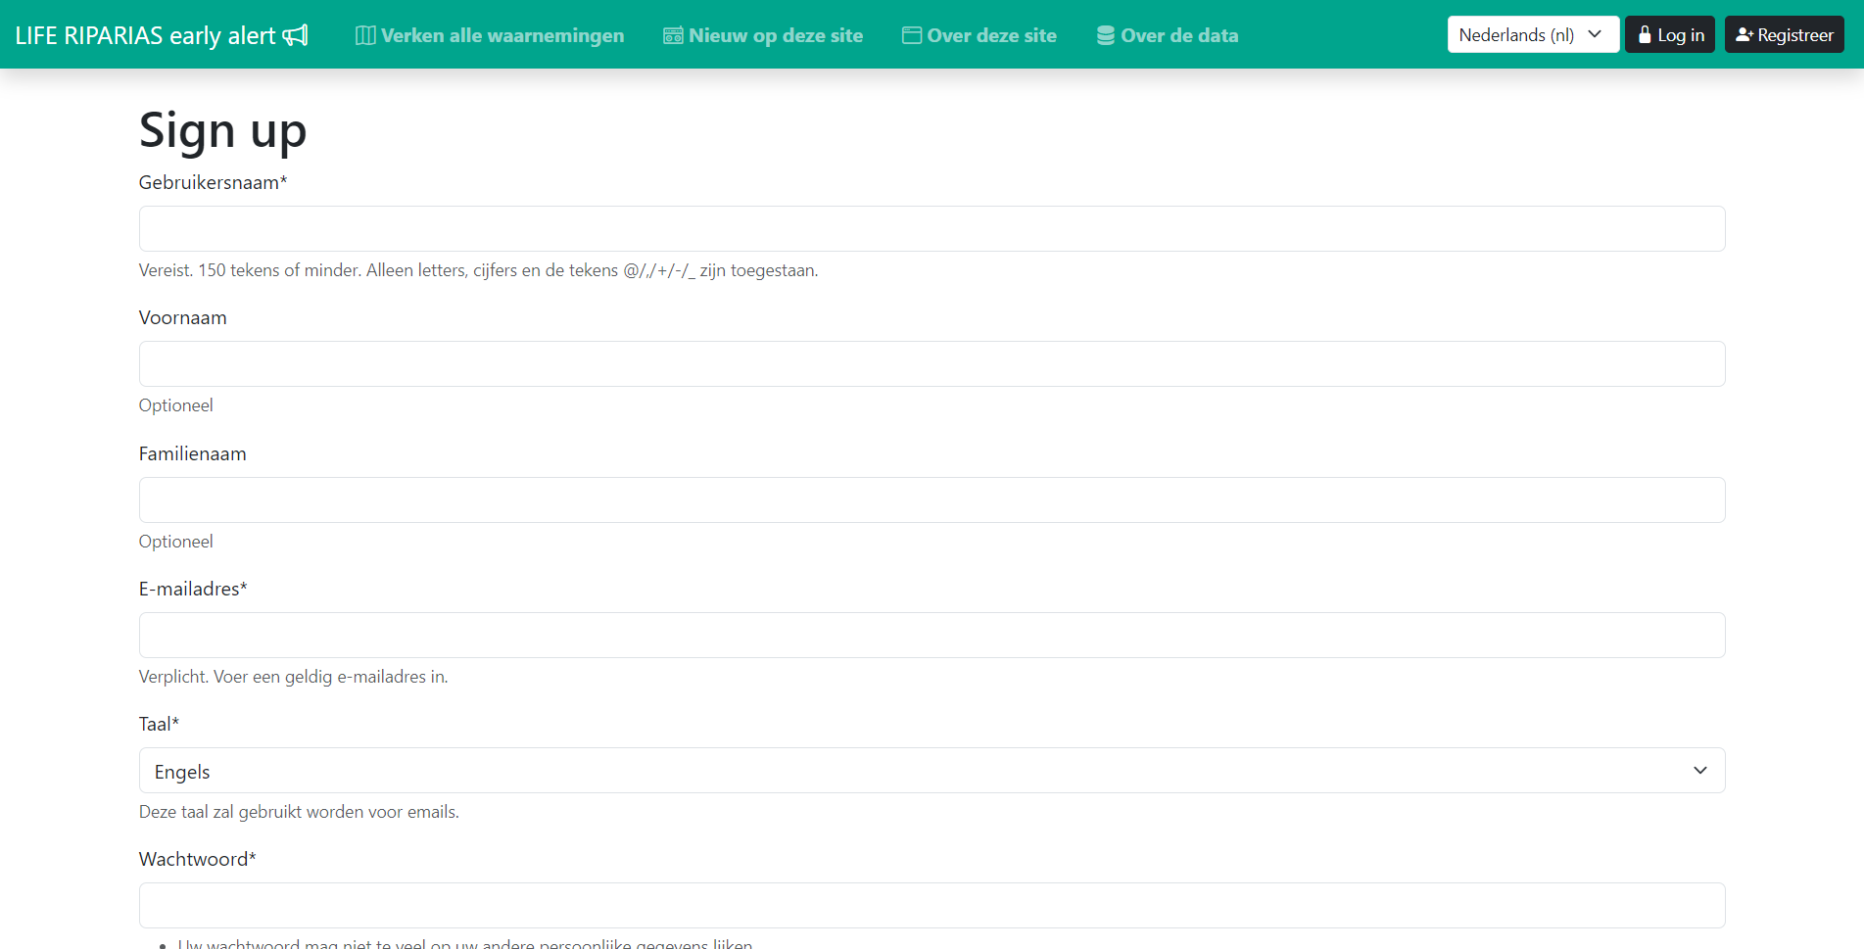
LIFE RIPARIAS early alert: sign in/ sign up
Set your own alerts by creating a new account

Slide 25
LIFE RIPARIAS early alert: after sign up
All observations are “unseen” to the user the very first time he/she logs in. You can “Mark all observations as seen”. It might take a while the first time…
Notes:
Refreshing the page after a while to see the progress of marking all as seen.

Slide 26
LIFE RIPARIAS early alert: create your alerts
Configure your alerts based on:
Species: one or more LIFE RIPARIAS target list
Areas: (LIFE RIPARIAS) river basins, Natura2000 areas, provinces, regions or custom areas
Datasets: GBIF datasets observations belongs to
Email notifications frequency: daily, weekly, never, …
And explore matching observations
No limit on the number of alerts.

Slide 27
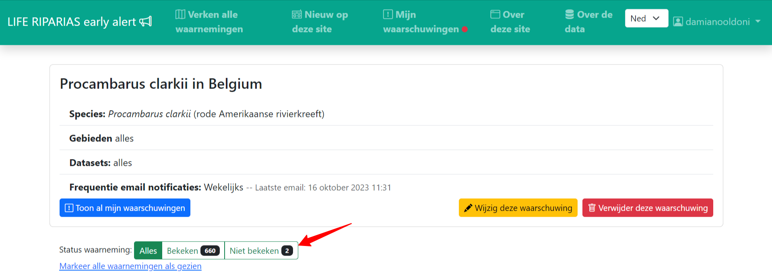
LIFE RIPARIAS early alert: seen-unseen observations
You can visualize all/seen/unseen observations in both Map View and Table View

Slide 28
LIFE RIPARIAS early alert: seen-unseen observations
You can visualize all/seen/unseen observations in both map View and Table View
Seen observations can be flagged back as unseen on observation page at any time

Slide 29
LIFE RIPARIAS early alert: seen-unseen observations
You can visualize all/seen/unseen observations in both map View and Table View
Seen observations can be changed back to unseen on observation page
You are visually notified if unseen observations are matching your alerts

Slide 30
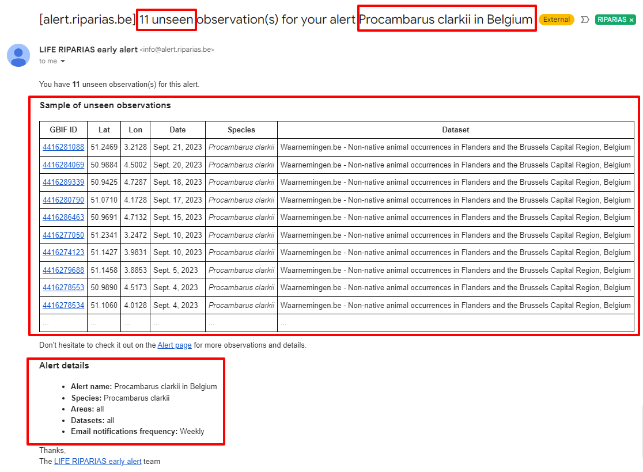
LIFE RIPARIAS early alert: mail notifications
Notes:
Mail subject: xx unseen observations for your alert “name of the alert”.
Mail body:
sentence: “You have xx unseen observation(s) for this alert.”
Sample of the unseen observations (max 10)
Sentence with link to the Alert page
Alert details
Signature

Slide 31
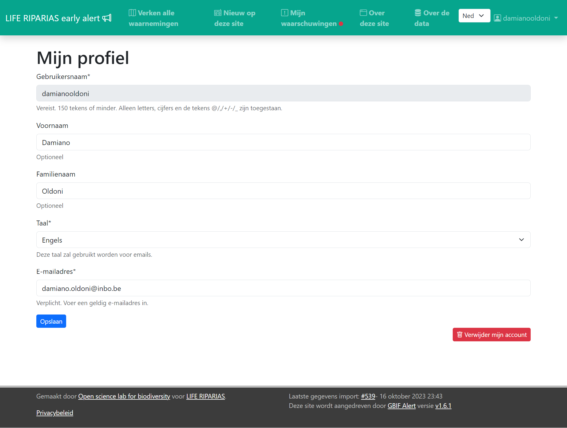
LIFE RIPARIAS early alert: my profile
Configure your contact details:
First name
Last name
Email (important for notifications)
Language
Username cannot be changed.

Slide 32
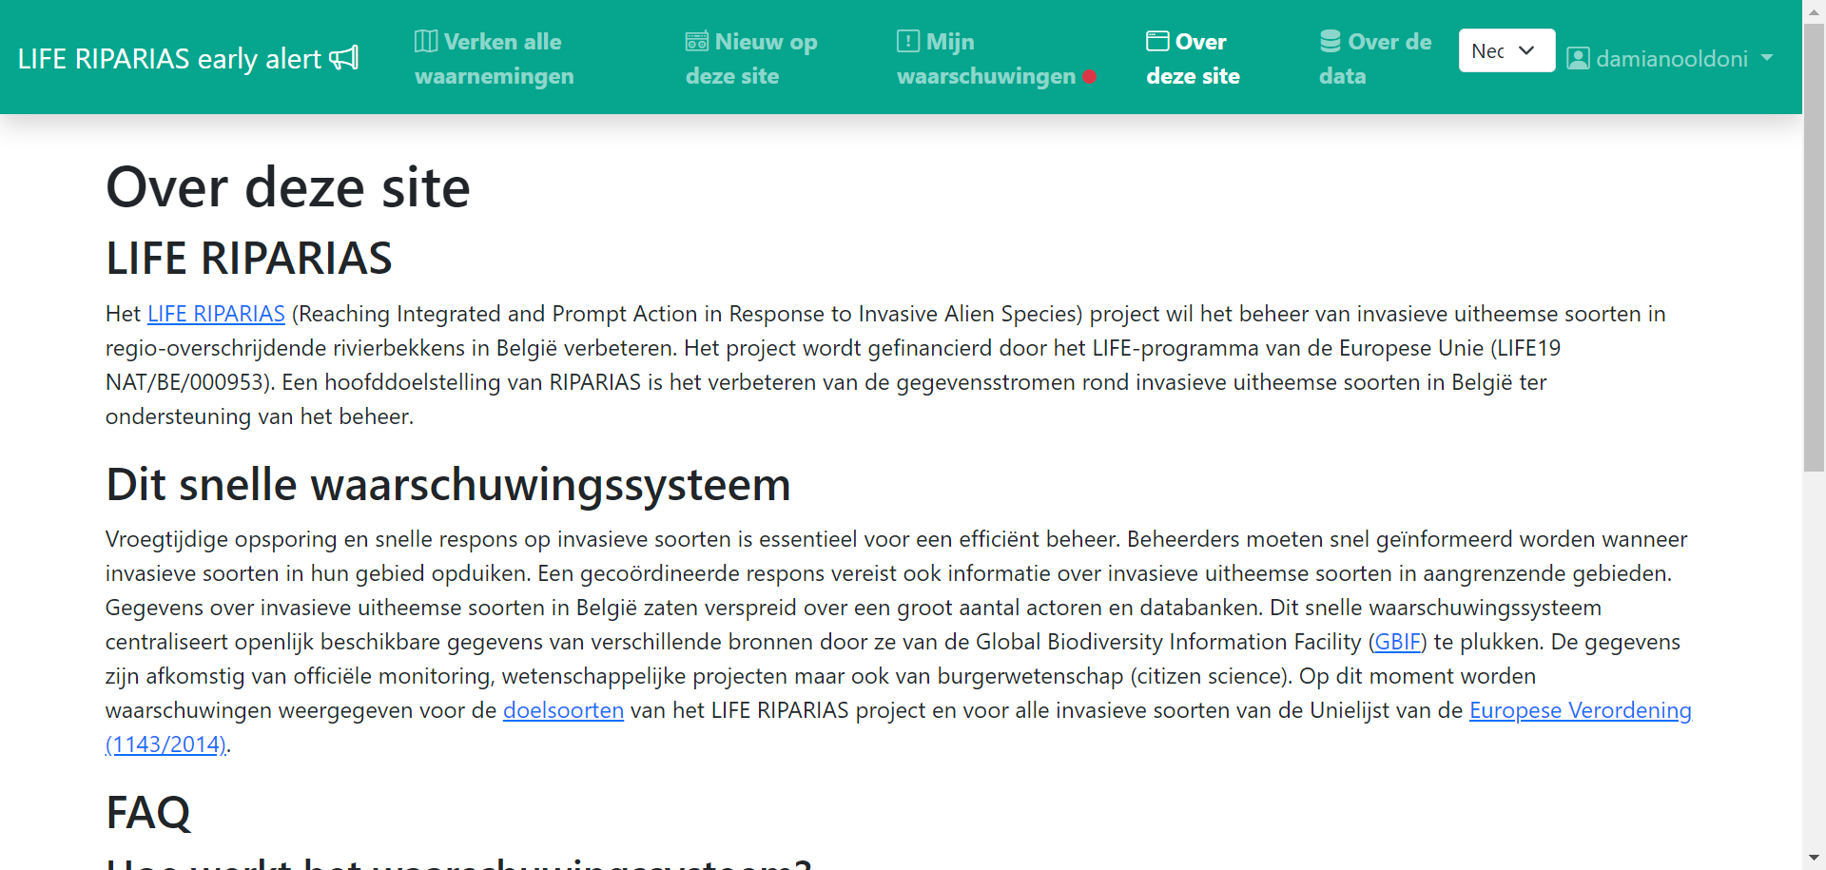
LIFE RIPARIAS early alert: more info
Please give a look to the “About this site” page

Slide 33
Thank you!
Damiano Oldoni
Tim Adriaens
Open Science Lab for biodiversity (oscibio)
Research Institute for Nature and Forest (INBO)
LIFE RIPARIAS homepage
LIFE RIPARIAS early alert tool
Slides: pptx, pdf

